Slide 1
Using Generative Artificial Intelligence in Medicine: ChatGPT and Beyond
November 18, 2023
Harry B. Burke, M.D., Ph.D.
Professor of Medicine
Uniformed Services University of the Health Sciences, Bethesda, MD
harry.burke@usuhs.edu
Adjunct Professor of Biochemistry & Molecular Medicine
George Washington University
Albert Hoang, PhD, DSc.
Assistant Professor
Uniformed Services University of the Health Sciences

Slide 2
Disclaimers
The ideas and opinions expressed in this presentation are those of the speaker and do not reflect the official policies or positions of the U. S. Federal Government, the Department of the Defense, the Defense Health Agency, or the Uniformed Services University
The speaker does not have any conflicts of interest to disclose

Slide 3
Introduction
Our research background is in artificial neural networks and natural language processing
I teach a four week course on Generative Pretrained Transformers
This talk is a brief overview of a compelx and powerful tool
Warning: What I am going to discuss is as dangerous as pandemics and nuclear weapons

Slide 4
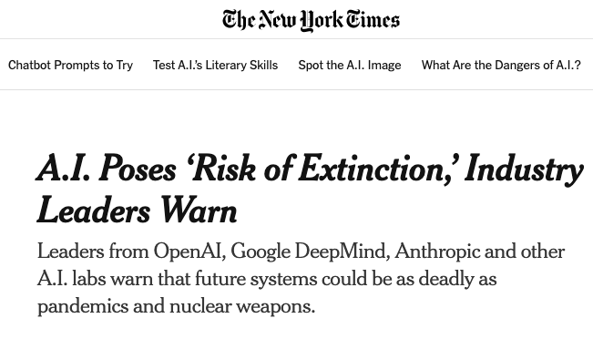

Slide 5
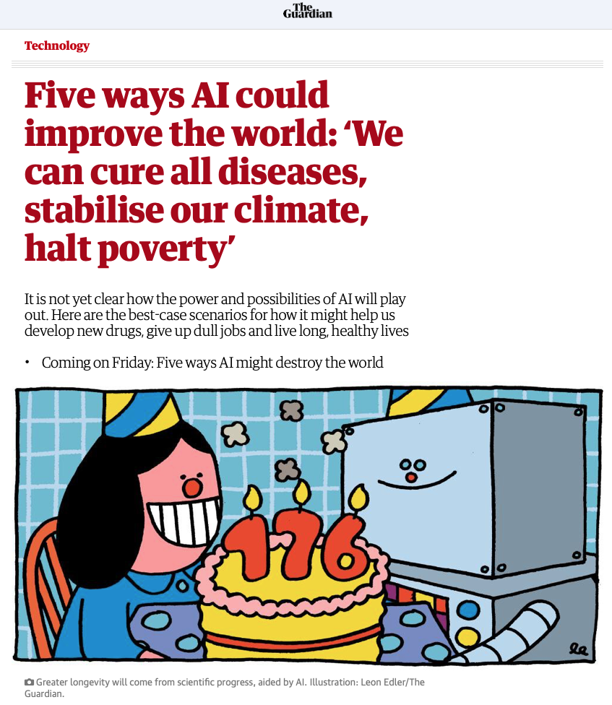

Slide 6
I want a machine that can think
“If you tell me precisely what you want a machine to do then I can always make a machine which will do just that.”
John von Neumann (1903 – 1957), an inventor of MANIAC (Mathematical Analyzer, Numerical Integrator and Computer)
A.O. Scott, Blame Prometheus. New York Times Book Review, October 29, 2023, p. 11.

Slide 7
Autocompletion programs
Autocompletion programs have been around since 1967 (H. Christopher Longuet-Higgins, Computer-Assisted Typewriter)
As you type the letters of a word, the program predicts the word that you are typing, it selects that word from a number of candidate words
Autocomplete programs are used in word processing software, web browsers, email programs, search engines, etc.
At its most basic level, a Large Language Model is a natural language program that can autocomplete

Slide 8
Generative Pretrained Transformer (GPT) terminology
“Generative AI” – any artificial intelligence algorithm that generates an output, examples include text, music, computer code, foreign language, mathematics
“Pretrained” – on text, and/or pictures, of music, or computer code, or math, or foreign languages, etc.
“Transformer*” – a specific AI algorithm that transforms input to output
“Large language models” (LLM) – trained on a large amount of text, it accepts text prompts, and it generates text output
ChatGPT, Bard, Llama, etc. are all LLMs based on the Transformer architecture
There are many Transformer-like programs – they resemble Transformer but they have somewhat different architectures
Their use is all about the prompts
*Vaswani A, Shazeer N, Parmar N, Uszkoreit J, Jones L, Gomez AN, Kaiser L, Polosukhin I. Attention Is All You Need. June 12, 2017. arXiv:1706.03762v5. https://doi.org/10.48550/arXiv.1706.03762

Slide 9
Natural language processing programs
Natural language processing programs (NLPs) address meanings in text
There are two types of natural language processing programs
receptive (finds meanings in natural language)
generative (outputs meaning-relevant natural language)
A generative pretrained transformer (GPT) program is an NLP program that autocompletes by outputting the highest probability next word from a number of candidate words
Because of the amount of natural language it is trained on, a GPT is called a Large Language Model
In other words, LLMs are receptive and generative NLPs
An incidental byproduct of their learning a huge amount of language is that they became a Large Knowledge Model (LKM)
They learned the meanings contained in the natural language

Slide 10
Large Knowledge Models (LKM)
LLMs encode and decode natural language, which allows it to receive natural language input and to produce natural language output
But much of an LLM’s power comes from it containing and integrating large amount of human knowledge
Thus, a better name for these models is large knowledge models (LKMs)

Slide 11
Generative Pretrained Transformers (GPT) can perform three tasks
1. Natural language processing (Large Language Models)
2. Information processing (Large Knowledge Models*)
3. Emulate human cognitive and affective processes (Human-like models*)
GPT is a tool
Historically, we judged tools on how much value they add to human activity
Now, we will judge human activity on if it adds value to a GPT
*This is my terminology.

Slide 12
GPT domain
Statistics
(mathematics and probability)
Inferential (induction)
Descriptive
Algorithms
GPT Artificial intelligence (artificial neural networks, deep learning)
Decision trees
Support vector machines
Etc.
Learning
Unsupervised/
Supervised
Autonomous
Reinforcement
Classification/prediction
GPT Applications
Natural language processing
Knowledge systems
Human intelligence
Large Language Models
Large Knowledge Models
Human-like Models

Slide 13
Data
Unintegrated data
Library of Alexandria (collection of separate scrolls) (12 GB)
Library of Congress (largest library in the world, currently 74 TB)
Estimated that internet contains 50ZB (zettabytes) of data
Semi-integrated data
Google has indexed (but not fully integrated) 200 TB
a webpage is, on average, about 1MB
Fully integrated information
ChatGPT consists of 45 TB of integrated data
There is no natural limit on the amount of information a GPT can integrate

Slide 14
Relative magnitude of 45TB in terms of words
King James Version of the Bible = 783,137 words (1 volume)
That is 0.0039 GB
45 TB is over 11,500,000 bibles.
If stacked one on top of another, they would reach half way to the moon
Encyclopedia Britannica (2010 edition, 32 volumes) = 44 million words
That is 1.76 GB
45 TB is over 25,000 encyclopedias
It contains more information than one person could learn in thousands of lifetimes
Assumes that an average word length of 5 characters (including spaces and punctuation) and a common character encoding such as UTF-8

Slide 15
How the GPT algorithm works
Preprocessing (turns words into numbers) This is not a part of the transformer algorithm.
GPT algorithm (encodes, organizes, stores, and decodes information)
Attention (relates meanings to each other),
Artificial neural networks (organizes, stores, and retrieves information)
Foundation model can be ”fine-tuned”
Fine-tuning uses new data to modify the weight matrices (parameters) of the pre-trained artificial neural network model
A general GPT model needs large amounts of data for three reasons
Breadth of information – it must have many different types of information
Depth of information – it must know essential details
Repetition – it must learn patterns

Slide 16
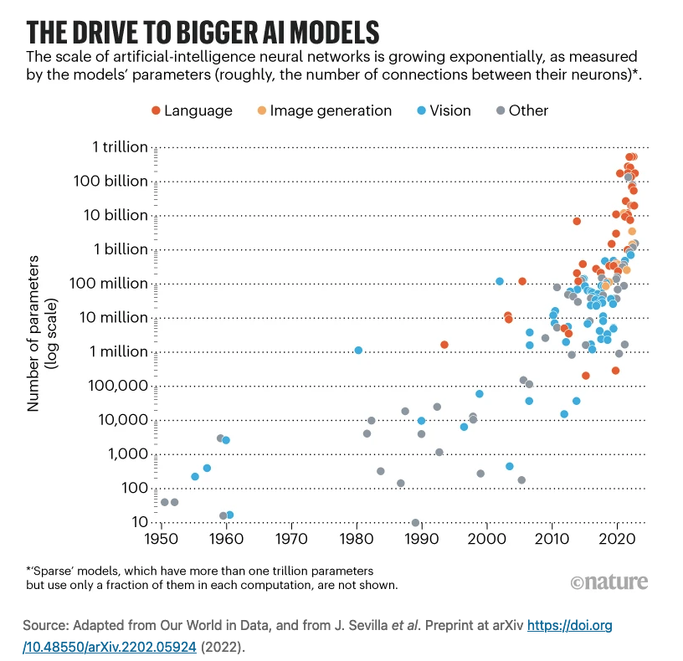
Currently, the largest number of
parameters in an AI model is 1 trillion

Slide 17
Generative pretrained transformer models rely on three axioms
1. Words closer together are closer in meaning
2. The more often a meaning occurs in the data the more likely it is to be the correct meaning
3. A computer system can learn, store, retrieve, and output information about language and the world
…
1. Words closer together are closer in meaning (the basic unit of information).
2. The more often a meaning (words close together) occurs in the data the more likely (highest probability) it is to be the correct meaning.
3. A computer system (an autonomous artificial neural network that operationalizes a self-organizing database) can accurately learn (enter in a systematic way), store, retrieve, and output information about language and the world.

Slide 18
GPT models (does not include BERT models)
Model | Developer | Training data | Tokens (strings of words) | Parameters | Release year
GPT Bert | Google (Vaswani) |  |  |  | 6/12/17
Tamagobot | Meta |  |  |  | 2020
ChatGPT-3 | Microsoft/OpenAI |  | 200 billion |  | 2020
LaMDA | Google |  | 1.5 trillion |  | 2021
Chinchilla | DeepMind/Google |  | 1 trillion |  | 2022
Blenderbot | Meta |  |  |  | 8/2022
PaLM | Google |  | 780 billion | 340 billion | 2022
Galactia | Meta |  |  |  | 11/16/2022
ChatGPT-3.5 Bing search | OpenAI Microsoft | 45 TB | 300 billion | 175 billion | 11/30/2022
GPT-4 Bing search | OpenAI Microsoft | 45 TB Multimodal |  | 1 trillion | 2023
LLaMA | Meta |  | 1.4 trillion |  | 2023
PaLM 2 | Google |  | 3.6 trillion |  | 2023
Bard Google search | Google Adobe Firefly |  |  |  | 2023
Gemini | Google DeepMind AlphaGo | Multimodal |  |  | 2024 ?

Slide 19
Meet the Generative Pretrained Transformer family
Children: ChatGPT & GPT-4
Ancestors: Many
Parent: Google - Transformer architecture
Parent: OpenAI – Large language model implementation
Adoptive parent: Microsoft
Other children
Galactica,* BlenderBot* (Meta)
BERT* (Google) – Based on PaLM 2, (Bidirectional Encoder Representations from Transformers)
DuetAI (Google)
PaLM2, Minerva* (Google) – 3.6 trillion token training (strings of words), 340 billion parameters
365 Copilot (Microsoft)
Llama 2 (Meta) [Large Language model Meta AI]
BARD (Google) – Chatbot, (Blender-based Architecture for Dialogue), 1.56 trillion words, based on LaMDA (Large Model for Dialogue Applications) and PaLM (Pathways Language Model)
Copilots (Microsoft) - writes code using natural language prompts, will be integrated into Office 360
Ernie (Baidu) – (Enhanced Representation through Knowledge Integration)
Claude (Anthropic)
Character (Character Technologies)
Close relatives
MedPaLM (Google) – medical
ChatGPT + Wolfram Alpha - math
AlphaCode (OpenAI) – programming
DALL-E 2 (OpenAI) – text to image
Make-A-Video (Meta)
Midjourney – text to image
Stability AI
MusicLA (Google) – music
TransformerJM – longitudinal outcome prediction
Runway – visual effects
Firefly (Adobe) – pictures
Magic Editor (Google) – pictures
MedQA, PubMedQA, MedMCQA, and MMLU – medical datasets
Google’s Generative AI App Builder, Vertex aI, PaLM API, MakerSuite
*Deceased, **Retired

Slide 20
History of ChatGPT
DeepMind purchased by Google in 2014 for $500,000,000
Sam Altman, CEO of OpenAI
OpenAI (nonprofit), founded in 2015
Received $1,000,000,000 in initial funding
Transformer architecture developed by Google, paper published in 2017
OpenAI LP (for profit, development and commercialization), founded in 2019
Microsoft’s initial investment for exclusivity, $1,000,000,000
Microsoft owns 49% of OpenAI LP
Profits spit between OpenAI and Microsoft
Total committed Microsoft investment, $13,000,000,000
Runs on Microsoft Azure serves
Release of ChatGPT-3.5: November 30 2022 (https://openai.com/blog/chatGPT)
A record 100,000,000 uses by February 2023 (2 months)
ChatGPT is free, GPT-4 is $20 per month, APIs are expensive
Over 1,000 organizations are using it, 53% of 500 companies surveyed plan to use ChatGPT (April, 2023)
ChatGPT website has 1,500,000 monthly visitors, one of the top 20 websites in the world (June, 2023)

Slide 21
A GPT search is not a Google search on steroids
Google Search
Crawlers continuously searches the internet in real time
Indexes electronic data contained in internet sites
Prompt generates a rank order list of websites, which can be exhaustive, that match the prompt
Ranking bases on instars, outstars, reputation, number of visits, etc.
Uses artificial neural networks for its indexing and predictions
Constantly indexing the latest information
ChatGPT algorithm
Contains electronic data from many sources (especially from the internet)
Prompt generates a “best answer”
Uses artificial neural networks for organizing, storing, and retrieving information
You can “tunnel down” the search (recursive search) by concatenating searches (it keeps track of the context) “nested” searches
Static architecture: It needs periodic updates
Both Microsoft and Google have combined their internet search and GPT query

Slide 22
Major companies with GPT products
MICROSOFT
(Azure)
Copilot
OpenAI
ChatGPT
GPT-4
Search engines equipped with GPT
Microsoft has Bing
Google has Bard
They can provide a list of references
$13B
Bing
GOOGLE
(Cloud Platform)
Gemini
Bard
$2B
ANTHROPIC
Claude
AMAZON
(Amazon Web Services)
$4B
Bedrock
META
(Facebook, etc.)
$33B
Llama 2
Note: This is more than the cost of U.S. Mercury program that sent a man in space $44B (current dollars)

Slide 23
ChatGPT/GPT-4 = 45TB + Transformer + Tuning
Preprocessing: turning input, words, shapes, etc., into numbers
Transformer architecture (foundational model)
Attention, weight and relate elements
Artificial intelligence - autonomous feedforward [reinforcement learning] neural networks organizes, stores, and retrieves information
Implementation
45TB - there has never this amount of data in a single integrated system
Data cutoff: Originally September 2021, it was been updated in 2023
175 billion neural network parameters
Organized collection of supercomputers (Azure)
5 years of work
1,000,000 programmer hours
Designing, implementing, and “fine-tuning” the system (transfer learning and creating ad hoc rules)
This is a colossal accomplishment!

Slide 24
Simplified flow chart of how GPT output is determined
Documents (a,b,c,d are words)
Prompt
Document 1
abc
Document 1
Vectors of numbers
Document 1
Document 1
Document 1
Document 1
Document a,b,c,d
1,2,3,4
1,2,3,4
1,2,3,4
1,2,3,4
1,2,3,4
1,2,3,4
ANN
Pr 0.06
e
Highest probability
next word
Document 1
Pr 0.90
d
Document a,b,c,e
1,2,3,5
d
1,2,3,5
Pr 0.04
c
Document abdc
1,2,4,3

Slide 25
Fortunately, you don’t need to understand a GPT in order to use it
Fortunately, you do not need to understand the intricacies of computer motherboards and integrated circuits in order to use a computer
Transformer architecture

Slide 26
GPT overview
It encodes natural language by turning sequences of words into numbers (vectors) and weighting the numbers based on meaning relationships
The information is organized by, and stored in, autonomous self-organizing artificial neural networks
The stored Information includes syntactic and sematic structures
The prompt accesses stored text information (weighted vectors) that is related to the prompt
Based on its stored vector patterns, the GPT predicts what the next output word should be (the highest probability word)
It has many high probability words to choose from, which means that its output will be very sensitive to the prompt
It almost never uses single sources, its response is almost always a blend of many sources
Recently, it has added the capability to perform internet searches and provide sources
It has “wobble” in that it can report slightly different results to the same prompt due to: ambiguity in the prompt, or learning from previous prompts, or small random changes in output probabilities
ChatGPT has its own text response writing “style”

Slide 27
How the GPT determines the correct answer
If ChatGPT is based on what people write, and if people write misinformation, won’t the GPT give me misinformation? No
Misinformation will be written in many different ways
True information will be written in a consistent way
The GPT will find and output the consistent information
“We find that we can considerably outperform greedy decoding by sampling k > 1 solutions (with a non-zero temperature) and selecting one using majority voting Wang et al. (2022). This consists of grouping predictions with respect to their final answer and selecting the most common answer.*
“Intuitively, the reason majority voting improves performance is that while there are many ways to answer a question incorrectly, there are typically very few ways to answer correctly.”*
This is scientific truth, truth with a small t.
*Lewkowycz A, Andreassen A, Dohan D, Dyer E, Michalewski H, Ramasesh V, Slone A, Anil C, Schlag I, Gutman-Solo T, Wu Y. Solving quantitative reasoning problems with language models. arXiv preprint arXiv:2206.14858. 2022 Jun 29.

Slide 28
Assessing the GPT answer
Use your expertise
Ask the GPT to review its answer and find its mistakes (internal check)
Enter the same prompt into another GPT
Check other sources
Google search
PubMed search
Textbooks
Colleague

Slide 29
Why a prompt doesn’t provide the best answer
Prompt
Too general, lacks detail and specificity
Too short, inadequate
Incorrectly written
Too complex, requires multiple nested prompts
You misunderstand what you are looking for (lack sufficient expertise)
When doing a nested search, you go too far down in the neural network
Information in the GPT
There is no correct answer
GPT contains outdated information
GPT contains incorrect information

Slide 30
GPT strengths and limitations
Strengths
Contains an immense amount of information
Integrates the information
Allows natural language input (prompts) and output
Can provide an explanation of its output
Is intelligent, can make inferences (new information that was not entered into the GPT)
Limitations
Because it combines many sources of information, it does not provide direct references
It can report indirect references
Static models
The prompt is critical to the correct use of the GPT
The user must assess the veracity of its answer

Slide 31
Hallucinations explained
A GPT will look for whatever you ask for
The system will always generate an output (unless your program it to not do so)
If there is no information, and it knows there is no information, it will say there is no information
If there is no information, and it does not know there is no information, it will provide an output by associating what it knows that is analogous to what you want

Slide 32
Hallucination (Bard)

Slide 33
Hallucination (ChatGPT)
This answer is not intrinsic to ChatGPT. ChatGPT was fine-tuned to produce this answer.

Slide 34
Accelerating number of medical GPT publications (a lagging indicator)

Slide 35
Clinical case
Differential diagnosis of 20 year old female with mouth sore for one week, mild headache, finger tenderness, and anemia
Correct diagnosis: Systemic lupus erythematosus

Slide 36
Google search

Slide 37
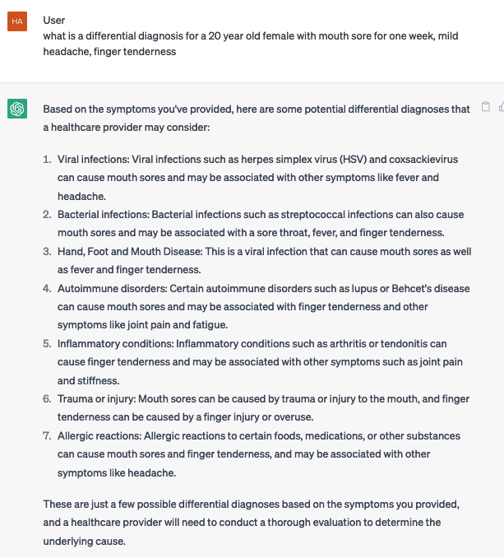
A ChatGPT differential diagnosis interaction – without anemia

Slide 38
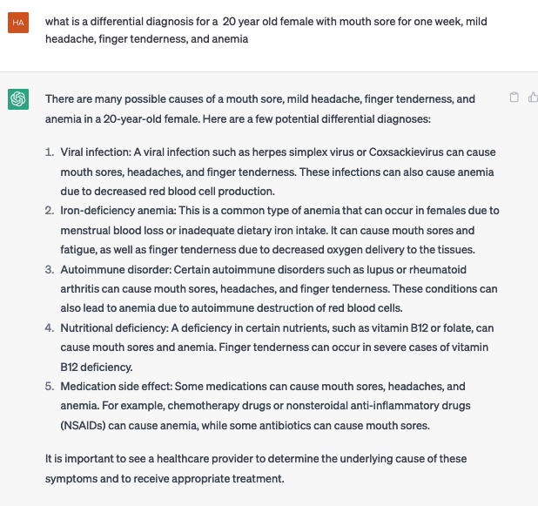
Add “anemia”

Slide 39
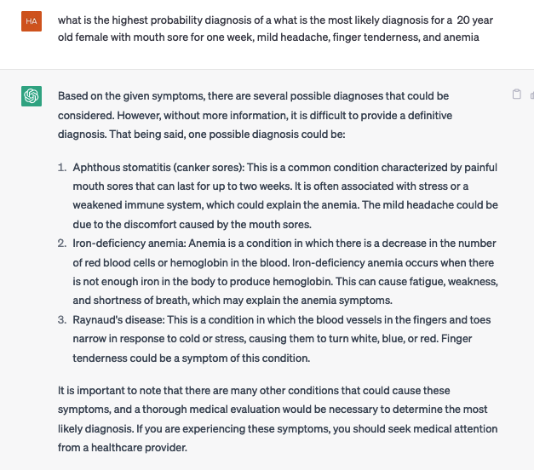
Changed to “highest prior probability diagnosis”

Slide 40
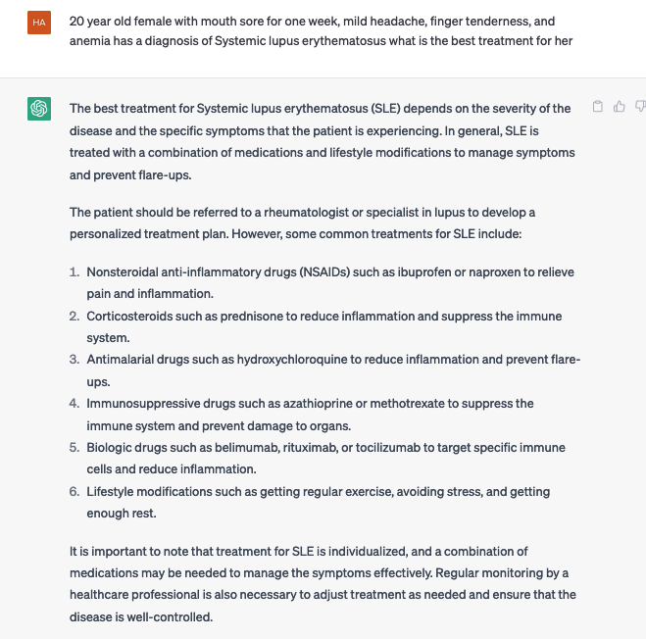
What is the best treatment for this patient?

Slide 41
Medication

Slide 42
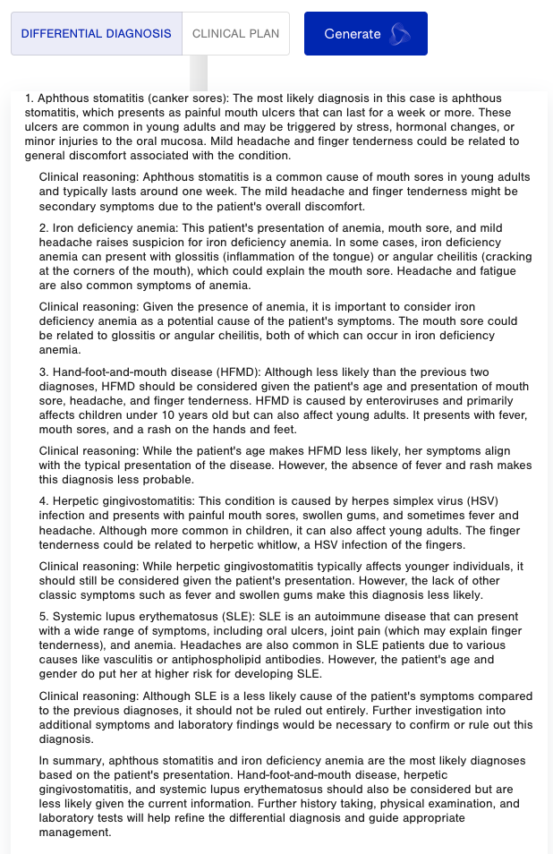
Glass Health
https://glass.health/ai

Slide 43
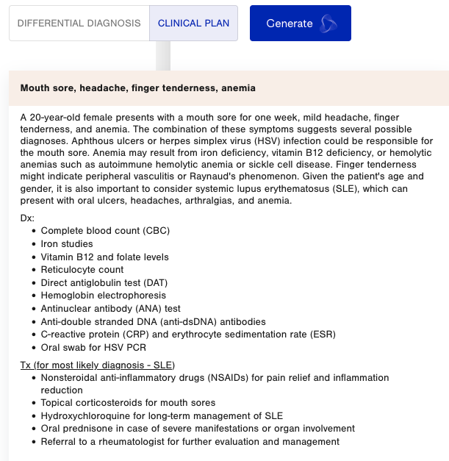
Glass Health

Slide 44
Cautions for GPT users
Have sufficient knowledge of medicine and of GPT to create proper prompts
Be careful with nested prompts
Perform internal and external checks of GPT output

Slide 45
GPT danger?
The main danger does not arise from the GPTs themselves
It arises from us – from how we create, modify, and use them
People have social, political, ideological, and religious views that they want to impose on others
They will try to modify and censor the GPTs in order to make them conform to their views
This will make GPTs unreliable and its output suspect

Slide 46
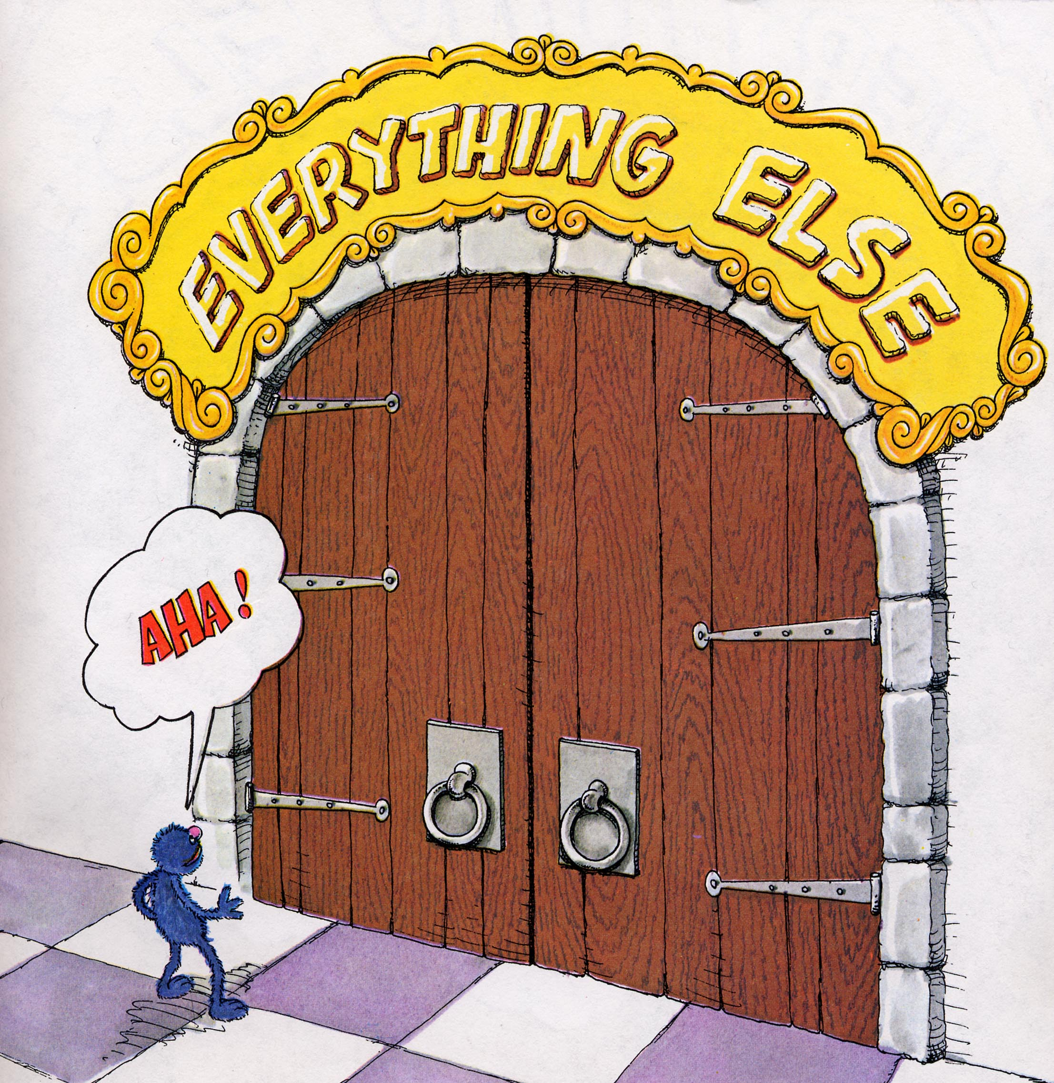
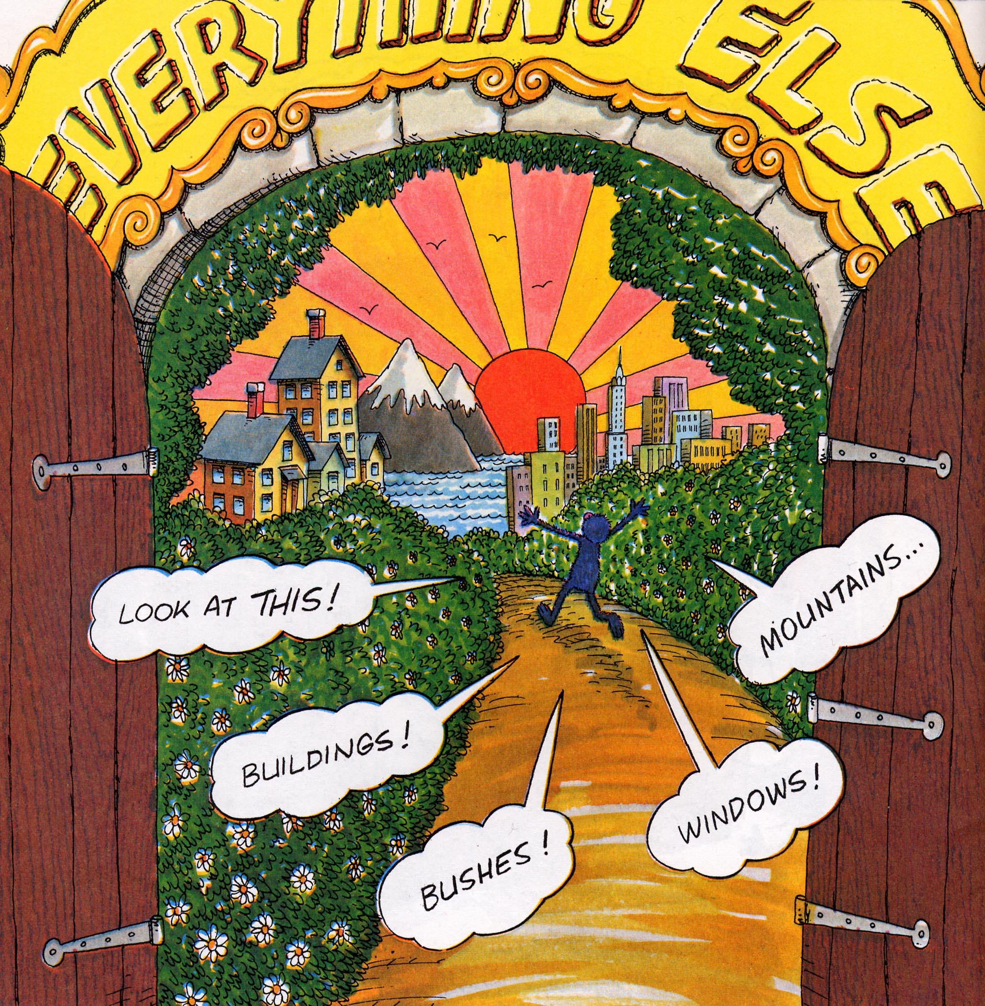
Most medical information has not been readily available for clinical use
Natural Language Models can make medical information available
Large Knowledge Models can make it clinically useable
Everything that is known has become knowable

Slide 47
Role of the physician

Slide 48
How will the role of the health professional change?
Prompt to ChatGPT: The role of the health professional will also change in a future where general artificial intelligence makes its way into clinical workflows, and medical professionals may need a basic understanding of AI technologies in order to critically appraise recommendations or explain to their patients why a specific recommendation or diagnosis was made.
ChatGPT’s answer: Yes, I agree. As AI technologies become more integrated into clinical workflows, it will be important for medical professionals to have a basic understanding of these technologies and how they work.
This will enable them to better understand the recommendations and diagnoses generated by AI models, as well as to critically appraise their validity and potential biases.
Additionally, medical professionals may also need to be able to explain these concepts to patients and answer any questions they may have. This will require ongoing education and training for medical professionals to keep up with the rapid advancements in AI technologies.

Slide 49
To use large knowledge models (LKMs) in medicine requires meta-knowledge
A physician needs to know:
The medical domain
How LKMs work
How to use a LKM
What input information a LKM needs
How to enter a prompt into the LKM
How to understand the LKM’s output
How to assess a LKM’s accuracy and completeness

Slide 50
AI impact on physicians – “Metadoctors”
Theorem: “A person working in partnership with an information resource is ‘better’ than that same person unassisted.”*
Medicine will be a joint activity: technology + physician (symbiotic mutualism)
Medicine will become more quantitative and complex
Medicine will become more accurate, effective, and productive
Physicians will no longer be expected to know everything
Instead, physicians will be expected to be experts at acquiring the best information, interpreting it, and using it in patient care
This includes using predictive models for risk, diagnosis, prognosis and treatment
This will require a new kind of competency, one not based on comprehensive medical knowledge – because a LKM has more medical knowledge than physician can ever have
Rather, physicians must be able to accurately and efficiently acquire and use medical knowledge
There will also be an increased emphasis on a physician’s bedside manner
There will be more of a focus on patents’ values and preferences
Administrative costs will be reduced
Patient safety and quality of care will improve
AI will take over EHR input and output
*Friedman CP. A "fundamental theorem" of biomedical informatics. J Am Med Inform Assoc. 2009 Mar-Apr;16(2):169-70. doi: 10.1197/jamia.M3092.

Slide 51
Physicians’ role: It’s not just about Large Knowledge Models
“The good physician treats the disease; the great physician treats the patient who has the disease.” William Osler*
Physicians are given a special privilege, that of being able to devote their lives to caring for others
When the physician holds the suffering patient, the patient is no longer alone
Physician characteristics: sensitivity, compassion, empathy, kindness, caring, devotion, loyalty, tenacity, ingenuity, creativity
The physician: must have a deep knowledge of the patient, must provide continuity of care, and must establish mutual respect and trust
*Osler, W. Aequanimitas : with other addresses to medical students, nurses and practitioners of medicine. Philadelphia: P. Blakinson’s Son & Co, 1904. https://archive.org/details/aequanimitas00osle/page/436/mode/2up

Slide 52
Future
“We speculate that GPT-4 will soon be followed by even more powerful and capable AI systems — a series of increasingly powerful and generally intelligent machines. These machines are tools, and like all tools, they can be used for good but have the potential to cause harm. If used carefully and with an appropriate degree of caution, these evolving tools have the potential to help health care providers give the best care possible.”*
Generative AI models will talk directly to other generative AI models
ChatGPT is just the tip of the generative AI iceberg. There are many things waiting to be discovered, things we can’t even imagine.
The rollout of generative AI in medicine is already occurring and will accelerate over the next 3 years.
*Lee P, Bubeck S, Petro J. Benefits, Limits, and Risks of GPT-4 as an AI Chatbot for Medicine. N Engl J Med. 2023 Mar 30;388(13):1233-9.

