Slide 1
Post COVID Conditions (“Long COVID”)
Kelly Gebo, MD MPH
Johns Hopkins University
November 18, 2023

Slide 2
Disclosures
Royalties: UptoDate
Consulting: Premier HealthCare, Harrison Consulting
Unpaid Consultant: Pfizer

Slide 3
Objectives
Describe current PCC epidemiology
Understand the potential pathophysiology in PCC
Discuss assessment and management of PCC symptoms
Describe current clinical trials in PCC

Slide 4
What is Long COVID? PCC? PASC?
Long COVID
  (Patient defined term)– any new symptoms after COVID
  (CDC) “Long COVID is broadly defined as signs, symptoms, and conditions that continue or develop after initial SARS-CoV-2 infection. The signs, symptoms, and conditions are present 4 weeks or more after the initial phase of infection; may be multisystemic; and may present with a relapsing– remitting pattern and progression or worsening over time, with the possibility of severe and life-threatening events even months or years after infection.

Slide 5
What is Long COVID? PCC? PASC?
Long COVID
  (Patient defined term)– any new symptoms after COVID
  (CDC) “Long COVID is broadly defined as signs, symptoms, and conditions that continue or develop after initial SARS-CoV-2 infection. The signs, symptoms, and conditions are present four weeks or more after the initial phase of infection; may be multisystemic; and may present with a relapsing– remitting pattern and progression or worsening over time, with the possibility of severe and life-threatening events even months or years after infection.
Post COVID Conditions (WHO) Broad range of symptoms (physical and mental) and symptom clusters that develop during or after COVID-19, continue for ≥2 months (ie, three months from the onset of illness), have an impact on the patient's life, and are not explained by an alternative diagnosis
Post Acute sequelae of SARS CoV-2 infection (PASC), Long Hauler

Slide 6
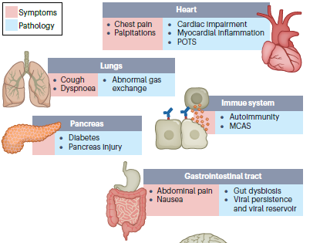
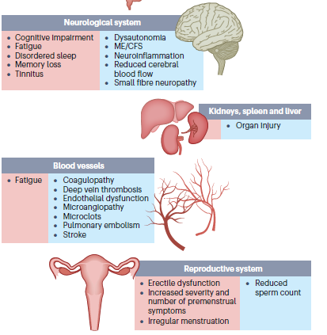
PCC Symptoms

Slide 7

PCC Epidemiology
Incidence
Prevalence
10–30% of non-hospitalized
50–70% of hospitalized cases
10–12% of vaccinated cases
As of January 2023
15% of all adults had PCC symptoms at some point
6% reported current symptoms.
20 million Americans affected with PCC
Ceban, F. et al. Fatigue and cognitive impairment in post-COVID-19 syndrome:a systematic review and meta-analysis. Brain Behav. Immun. 101, 93–135 (2022).
Al-Aly, Z., Bowe, B. & Xie, Y. Long COVID after breakthrough SARS-CoV-2 infection.Nat. Med. (2022).
Ayoubkhani, D., Bosworth, M. L., King, S., Pouwels, K. B., Glickman, M., Nafilyan, V., ... & Walker, A. S. (2022, May). Risk of Long Covid in people infected with SARS-CoV-2 after two doses of a COVID-19 vaccine: community-based, matched cohort study. In Open Forum Infectious Diseases.

Slide 8
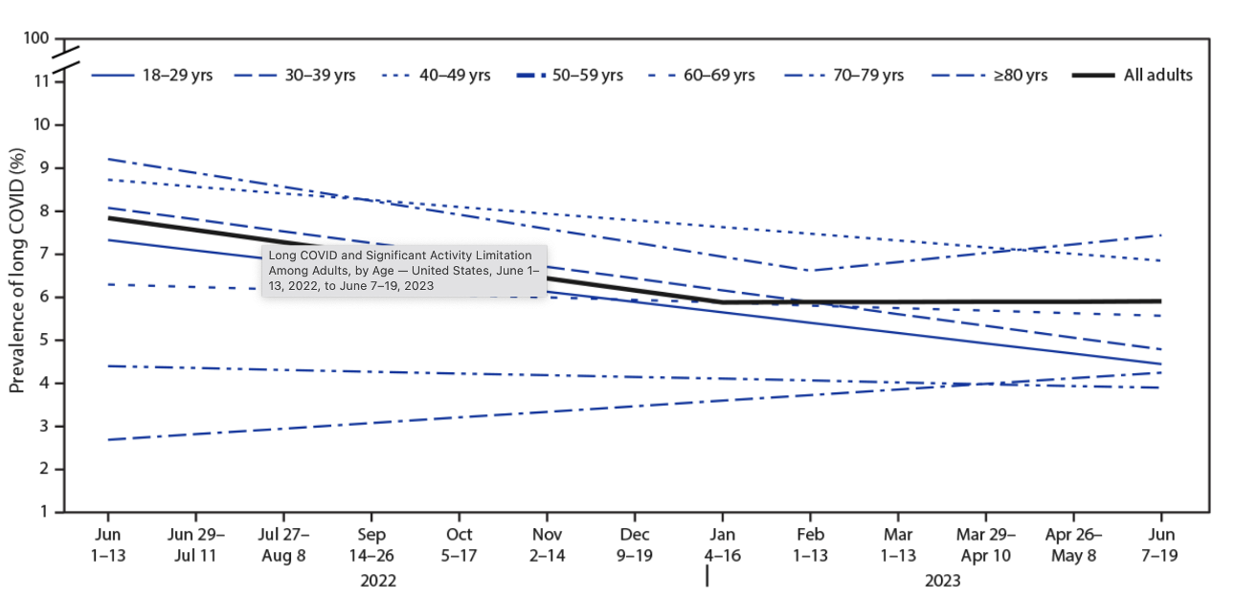
Prevalence: Decreasing across time
Notes:
CDC Household survey July-August 2022
17% of US adults ever COVID report PCC symptoms at 4 weeks
3/20-2/22
6.2% had 1 of 3 symptom clusters
Fatigue/bodily pain 3.2%
Cognitive problems 2.2%
Respiratory problem 3.7%

Slide 9
Difficulties studying PCC
Does the constellation of symptoms and persistent issues experienced by patients represents a new syndrome unique to COVID-19?
Overlap with the recovery from other infectious and critical illnesses?
Distinguish from Post Intensive care Syndrome (PICS)
Selection and reporting bias
Lack of standardized assessment protocols.
Who should the controls be
  Those with COVID and no symptoms: those without COVID? or those with another infection?

Slide 10
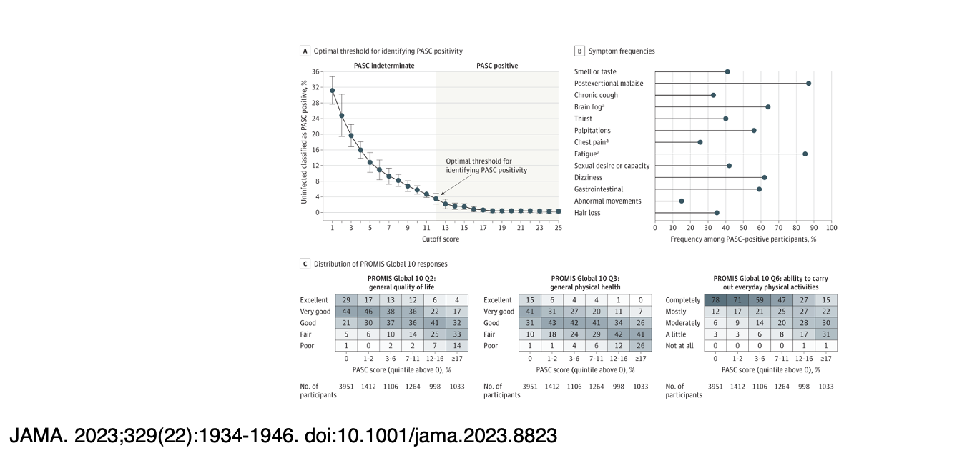
PASC Definition from RECOVER

Slide 11
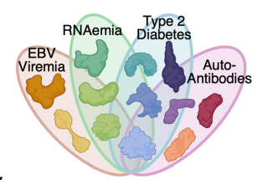
Risk Factors for Long COVID
Non-hospitalized adults
  Female sex
  Ethnic minority
  Socioeconomic deprivation
  Smoking
  Obesity
  Increased along a gradient of decreasing age
Subramanian, A., Nirantharakumar, K., Hughes, S., Myles, P., Williams, T., Gokhale, K. M., ... & Haroon, S. (2022). Symptoms and risk factors for long COVID in non-hospitalized adults. Nature Medicine, 1-9.
Su, Y., Yuan, D., Chen, D. G., Ng, R. H., Wang, K., Choi, J., ... & Heath, J. R. (2022). Multiple Early Factors Anticipate Post-Acute COVID-19 Sequelae. Cell.
Notes:
female sex, belonging to an ethnic minority, socioeconomic deprivation, smoking, obesity and a wide range of comorbidities. The risk of developing long COVID was also found to be increased along a gradient of decreasing age. SARS-CoV-2 infection is associated with a plethora of symptoms that are associated with a range of sociodemographic and clinical risk factors.

Slide 12
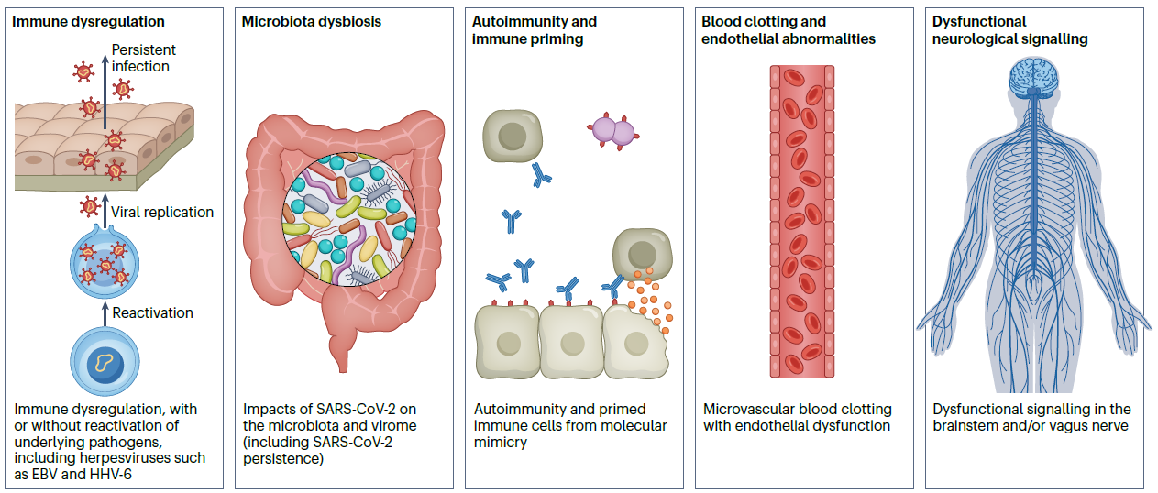
Theories on Pathophysiology of PCC
Davis, H. E., McCorkell, L., Vogel, J. M., & Topol, E. J. (2023). Long COVID: major findings, mechanisms and recommendations. Nature Reviews Microbiology, 1-14.

Slide 13
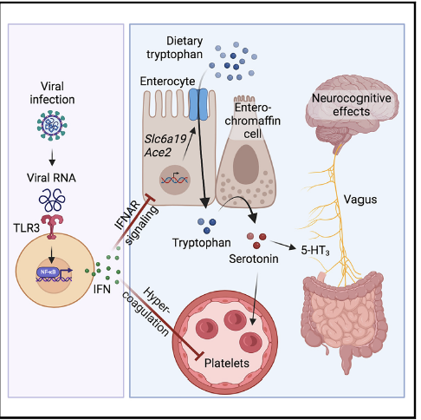
Serotonin reduction in PCC
PCC is associated with reduced circulating serotonin levels
Serotonin depletion is driven by viral RNA-induced type interferons (IFNs)
IFNs reduce serotonin through diminished tryptophan uptake and hypercoagulability
Peripheral serotonin deficiency impairs cognition via reduced vagal signaling
Notes:
Several hypotheses have been formulated to explain the etiology of PASC, including viral persistence, chronic inflammation, hypercoagulability, and autonomic dysfunction. Here, we propose a mechanism that links all four hypotheses in a single pathway and provides actionable insights for therapeutic interventions. We find that PASC are associated with serotonin reduction.
Viral infection and type I interferon-driven inflammation reduce serotonin through three mechanisms:
diminished intestinal absorption of the serotonin precursor tryptophan;
Platelet hyperactivation and thrombocytopenia, which impacts serotonin storage; and
enhanced MAO-mediated serotonin turnover.
Peripheral serotonin reduction, in turn, impedes the activity of the vagus nerve and thereby impairs hippocampal responses and memory. These findings provide a possible explanation for neurocognitive symptoms associated with viral persistence in PASC, which may extend to other post-viral syndromes.

Slide 14
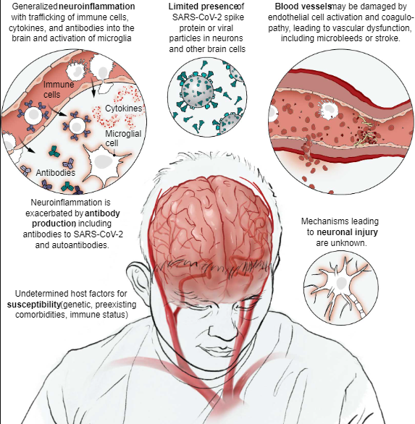
Neuropathogenic effects of SARS-CoV-2
22% to 26% of patients at 12 weeks post SARS-CoV-2 infection
Neuroinflammation
  Microglia activation
  Antibodies
Vascular damage
  Coagulopathy
  Endothelial dysfunction
  Injury to neurons
Spudich, S., & Nath, A. (2022). Nervous system consequences of COVID-19. Science, 375(6578), 267-269.

Slide 15
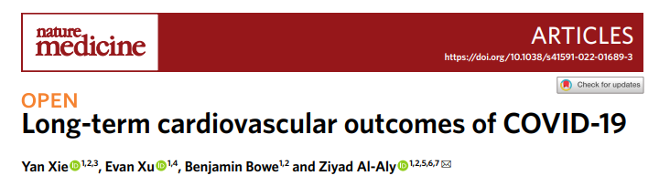
Cardiovascular Risk
One year risk
  Stroke 53% ↑
  MI 66%↑
  Arrythmia 69% ↑
  Blood clots (DVT,PE) 139% ↑
ICU> Hospitalized> Non hospitalized
1-year burden of cardiovascular disease in survivors of acute COVID-19 are substantial
Notes:
Increased risks in those not hospitalized
Graded increase risk across the severity
Severe>>>Mild
ear burdens of a set of pre-specified incident cardiovascular outcomes. We show that, beyond the first 30 d after infection, individuals with COVID-19 are at increased risk of incident cardiovascular disease spanning several categories, including cerebrovascular disorders, dysrhythmias, ischemic and non-ischemic heart disease, pericarditis, myocarditis, heart failure and thromboembolic disease. These risks and burdens were evident even among individuals who were not hospitalized during the acute phase of the infection and increased in a graded fashion according to the care setting during the acute phase (non-hospitalized, hospitalized and admitted to intensive care). Our results provide evidence that the risk and 1-year burden of cardiovascular disease in survivors of acute COVID-19 are substantial. Care pathways of those surviving the acute episode of COVID-19 should include attention to cardiovascular health and disease.

Slide 16
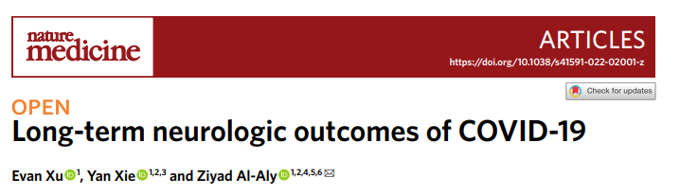
Neurologic Outcomes
Increased risk of
  Cognitive/memory disorders 80% ↑
  Peripheral nerve disorders 34% ↑
  MSK disorders 45% ↑
  Migraines, Seizures 32% ↑
  Movement disorders 42% ↑
  Mental Health 43% ↑
  GBS, TM, encephalopathy 46% ↑
Hospitalized = Non Hospitalized
Notes:
Increased risks in those not hospitalized
Graded increase risk across the severity
Severe>>>Mild
ear burdens of a set of pre-specified incident cardiovascular outcomes. We show that, beyond the first 30 d after infection, individuals with COVID-19 are at increased risk of incident cardiovascular disease spanning several categories, including cerebrovascular disorders, dysrhythmias, ischemic and non-ischemic heart disease, pericarditis, myocarditis, heart failure and thromboembolic disease. These risks and burdens were evident even among individuals who were not hospitalized during the acute phase of the infection and increased in a graded fashion according to the care setting during the acute phase (non-hospitalized, hospitalized and admitted to intensive care). Our results provide evidence that the risk and 1-year burden of cardiovascular disease in survivors of acute COVID-19 are substantial. Care pathways of those surviving the acute episode of COVID-19 should include attention to cardiovascular health and disease.

Slide 17
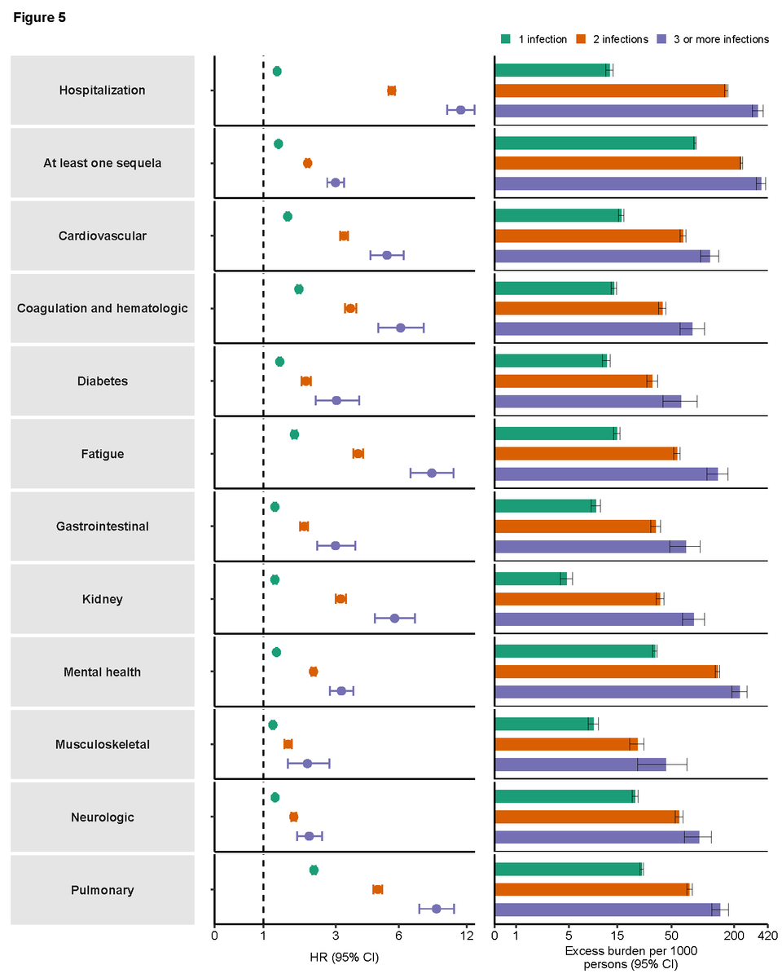
Outcomes of Reinfection
Increased cumulative risk in a graded fashion
Adds risks of mortality, hospitalization, and adverse health outcomes
Reducing overall burden of death and disease will require strategies for reinfection prevention
Outcomes of SARS-CoV-2 reinfection. Al-Aly, Z., Bowe, B., & Xie, Y. (2022).
Notes:
Compared to non-infected controls, assessment of the cumulative risks of repeated infection showed that the risk and burden increased in a graded fashion according to the number of infections. The constellation of findings show that reinfection adds non-trivial risks of all-cause mortality, hospitalization, and adverse health outcomes in the acute and post-acute phase of the reinfection. Reducing overall burden of death and disease due to SARS-CoV-2 will require strategies for reinfection prevention

Slide 18
PCC: Clinical Presentation and Management
Autonomic dysfunction
Fatigue
Neuropsychiatric/Cognitive

Slide 19
Autonomic dysfunction Initial Evaluation
After acute illness, was there a recovery followed by new sx 2-3 weeks after ?
Specific triggers?
  Change in position, activity
  Large Meals (high carbs)
  Hot weather or hot bath
  Dehydration (EtOH, poor PO intake due to nausea)
What makes it worse/better?
Functional Impairment
  Mobility
  ADLS
  Cognitive

Slide 20
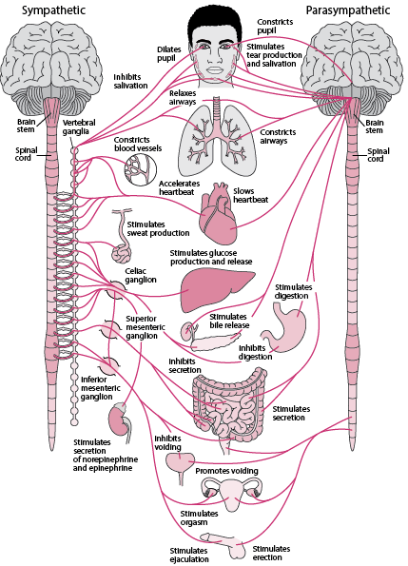

Screen for Dysautonomia
  Orthostatic intolerance
  Vasomotor dysfunction
  Secretomotor dysfunction
  GI dysfunction
  Urinary/Sexual dysfunction
  Pupillomotor dysfunction
Low, P. A. (Ed.). (2011). Primer on the autonomic nervous system. Academic Press.
Notes:
Are you able to tolerate standing for prolonged periods of time?
Are you experiencing changes in skin (color, flushing, goose bumps) ?
Any changes in the way you sweat and produce saliva or tears?
Have you experiences nausea, vomiting, diarrhea or constipation?
Any changes in bladder function (incontinence, retention)?
Have you noticed any changes in vision (difficulty focusing or adjusting to bright light)?

Slide 21
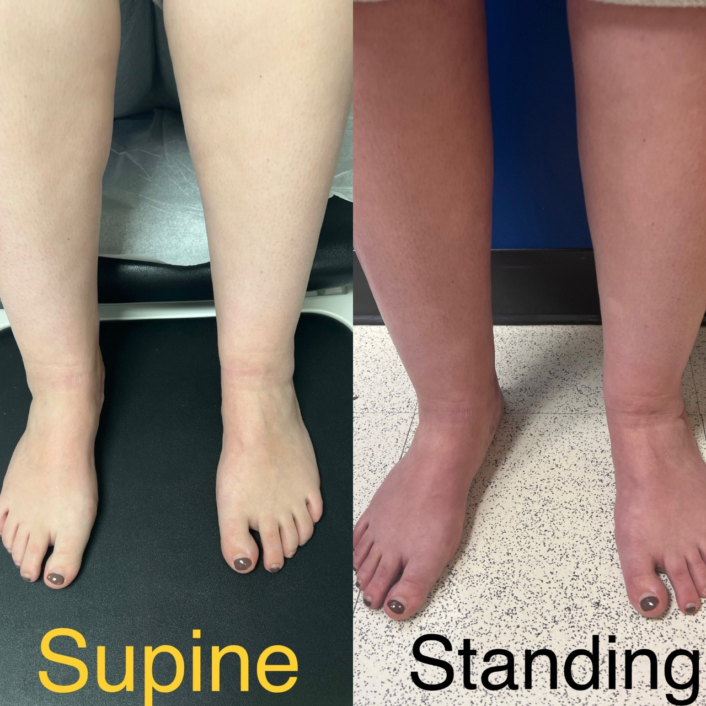
Initial evaluation of patients with
Autonomic Dysfunction symptoms
EKG
7 day Cardiac monitoring
Echocardiogram
10 minute passive standing test

Slide 22
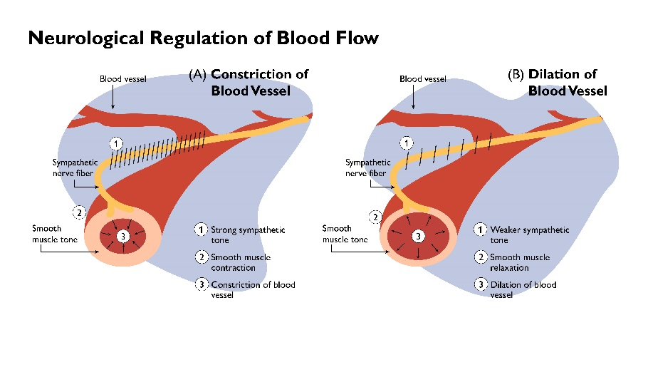
Postural Orthostatic Tachycardia Syndrome:
Mechanism
Slide Credit: Dr. Tae Chung
Notes:
Inability to regulate blood volume
Sympathetic denervation to blood vessels
Reduced preload to heart

Slide 23
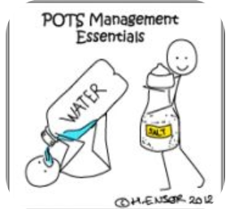
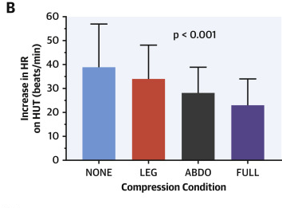
Non Pharmacologic treatment of
Autonomic Dysfunction
Increase Hydration
  Goal of 2-3 L per day
Increased Salt Intake
  Goal 4-10 gm daily
  Careful in patients with baseline HTN
Compression
  Lower extremities and abdomen
  20-30 mmHg

Slide 24

Initial Pharmacologic Treatment
Start low, and go slow
First line medications
  Low dose Beta blockers
    Propranolol 10 mg BID
    SE: Fatigue, lightheadedness
  Midodrine
    2.5 mg titration increments
    SE: Scalp tingling, goosebumps, supine HTN
  Fludrocortisone
    Start dose 0.1mg daily (….in some cases 0.05mg)
    SE: Swelling of LE
    Check K levels

Slide 25

PCC: Clinical Presentation and Management
Autonomic dysfunction
Fatigue
Neuropsychiatric/Cognitive

Slide 26

Initial evaluation of patients with fatigue
Rule out treatable causes of fatigue
  CBC, CMP, Iron studies, TSH, Vitamin B12, Vitamin D
  ESR, ANA, CRP, RF
Screen for sleep disorders
If suspected, work up for oncologic disorder or other (endocrine)
Screen for Post exertional malaise

Slide 27
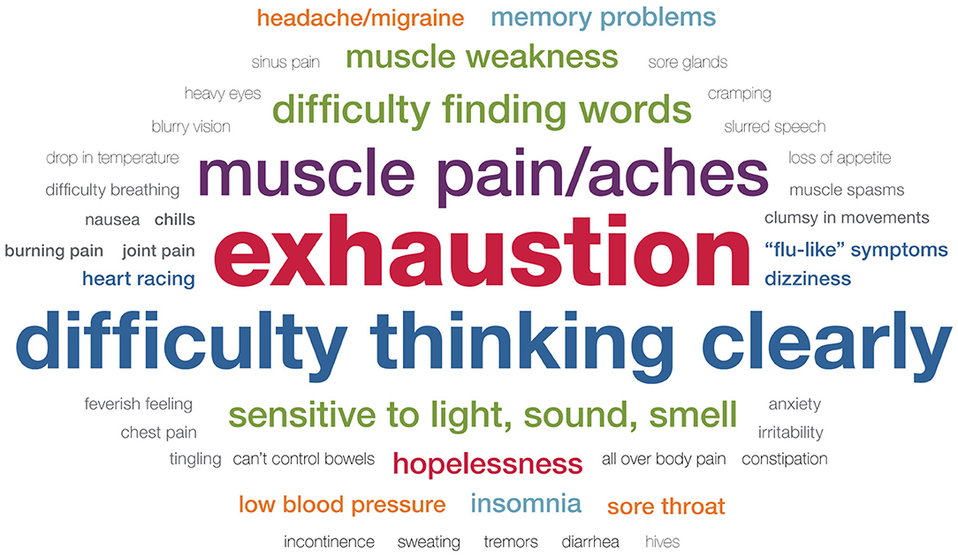
Post Exertional Malaise (PEM) or Post Exertional Symptom Exacerbation (PESE)
Stussman, B., Williams, A., Snow, J., Gavin, A., Scott, R., Nath, A., & Walitt, B. (2020). Characterization of post–exertional malaise in patients with myalgic encephalomyelitis/chronic fatigue syndrome. Frontiers in Neurology, 1025..

Slide 28

Every day is different

Slide 29
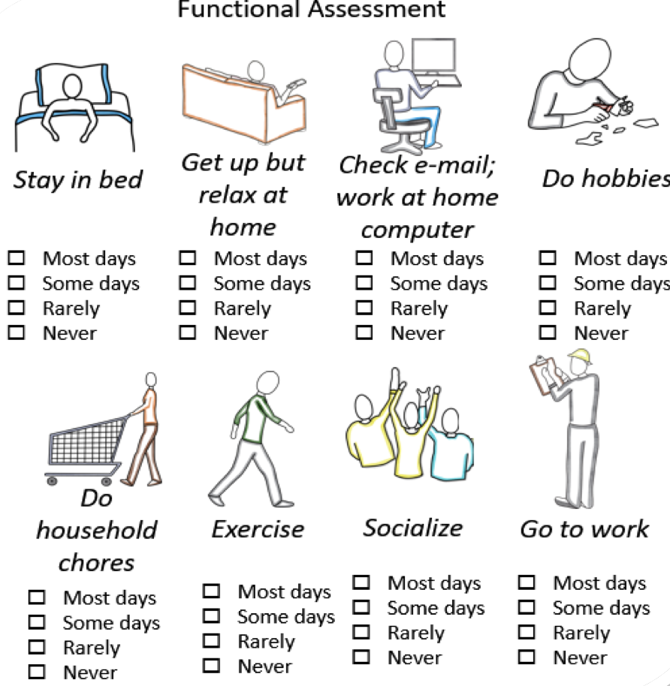
Activity Level
What are current activities
  Daily activities
  hobbies
  Household chores
  Exercise
  Socializing
  Work

Slide 30

PCC Energy Conservation recommendations
  4P’s:
    Pacing
      Slow and steady wins the race
    Prioritizing
      Patient centered
    Planning
      Prepare self and environment
    Positioning
      Body support through daily activities

Slide 31
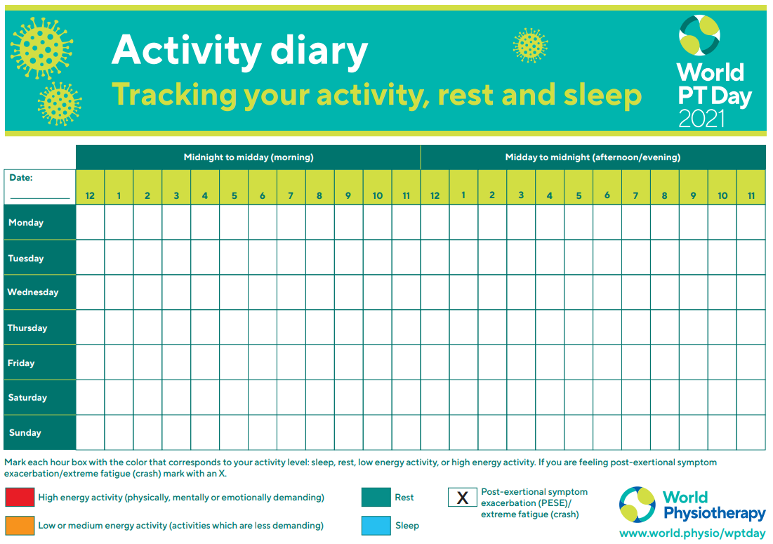

Slide 32
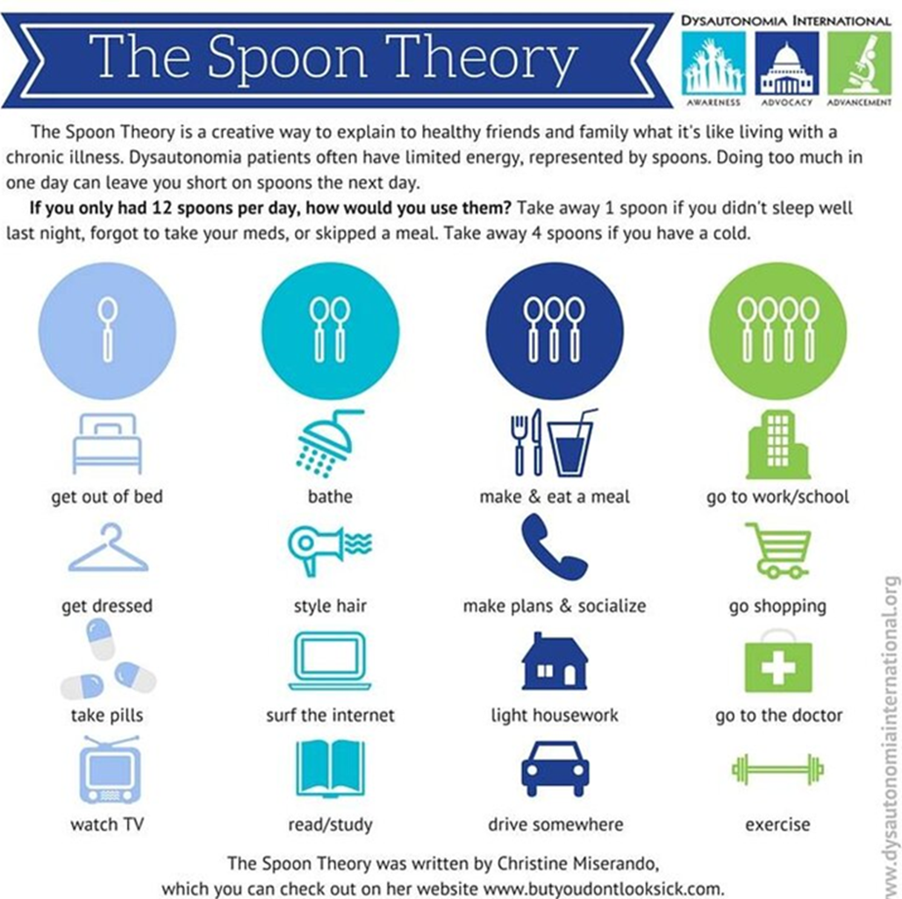

Slide 33
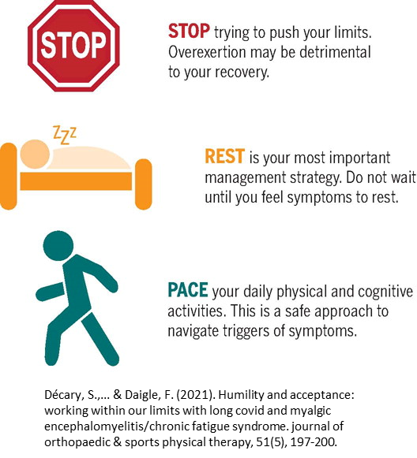
PCC fatigue treatment recommendations
Supporting Energy Conservation Strategies
  Assess need for DME or Parking Placard
  Reasonable Work Accommodations
  Referral to OT /PT
    Individualized to patients need
    Providers familiar with PEM
  Rehab Psychology Coping
Notes:
Work accommodation examples: interval breaks with work/screen time, seated work, extra time for tasks, remote if travel/driving leads to crash

Slide 34


Takeaway points on Post COVID Fatigue
Screen all patients for Post Exertional Malaise (PEM or PESE)
Individualized treatment approach and return to activities, at the patient own pace an not in a set timeline.
Emerging understanding of mechanisms… and hopefully interventions for treatment.

Slide 35
PCC: Clinical Presentation and Management
Autonomic dysfunction
Fatigue
Neuropsychiatric/Cognitive

Slide 36
Post-acute Neuropsychiatric Outcomes
Age-adjusted Standard Scores
67% of PACT patients showed mild/moderate cognitive deficit on ≥ 1 of 8 tests
65% non-ICU & 69% post-ICU.
Slide Credit: Tracy Vannorsdall, PhD
Notes:
Patients treated in the ICU as well as those who were not in the ICU tended to perform below expectations on most tests, particularly tests of fluency, processing speed, new learning, and memory
(Post-ICU scores are lower)

Slide 37
Post acute COVID Neuropsychiatric Outcomes
78% reported mild elevations on ≥ 1 measure
35% reported moderate elevations on ≥ 1 Measure
Slide Credit: Tracy Vannorsdall, PhD
Notes:
Note QDRS is heavily weighted to changes in fx due to mood and thinking
Scores on measures of depression, anxiety, and functional decline did not differ based on:
PACT clinic
and were unrelated to cognitive composite scores

Slide 38
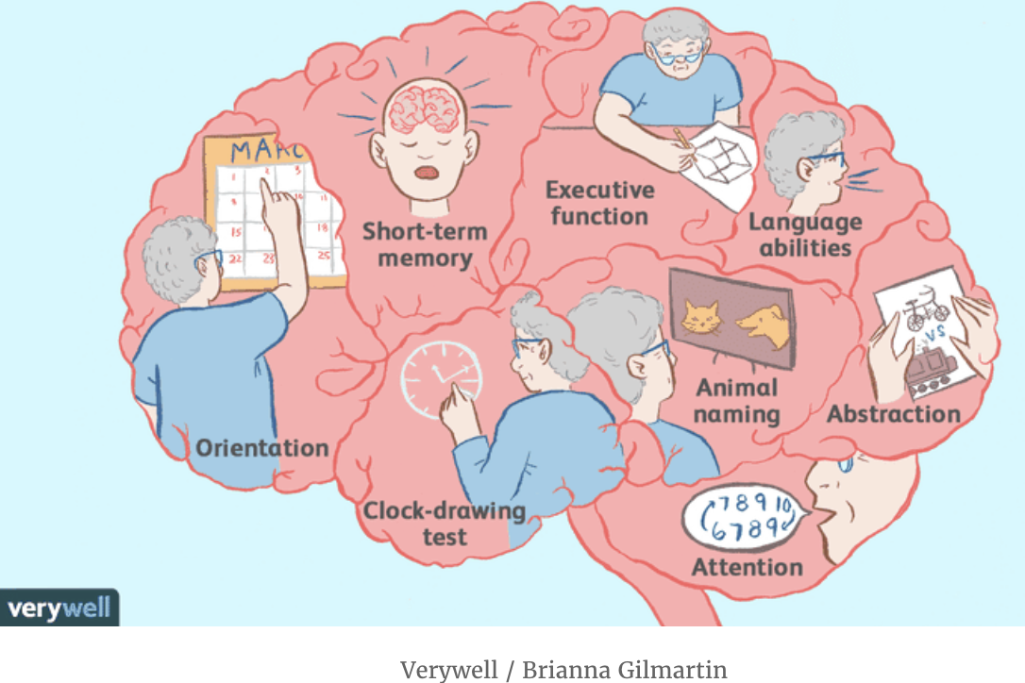
Cognitive Symptom Assessment
Screen for cognitive symptoms using validated tools
  MoCA, MMSE, SLUMS
Evaluate for conditions that may exacerbate cognitive symptoms
  Sleep, Mood, Fatigue, Polypharmacy
Neurological exam to identify focal deficits
  New or worsening focal deficits –consider imaging
Labs to rule out reversible causes of cog symptoms
  B12, thiamine, folate, homocysteine, vitamin D, magnesium, LFT, TSH, consider syphilis or HIV

Slide 39
Initial treatment of Neuropsychiatric impairments
Cognitive therapy by SLP
  Compensatory strategies and therapeutic
Neuropsychology
  Coping with impairments
  Neurocognitive testing
  Group therapy
  Memory clinic
Psychiatric
  Pharmacologic management

Slide 40
PCC Cognitive Pharmacologic Interventions: many theories
Stimulants
  Modafinil
  Amantadine
  Guanfacine + NAC
Supplements
  Omega 3, Zinc, beetroot juice, vitamin D, probiotics …
Notes:
Endogenous metabolic modulators

Slide 41
Catching up with the times!
As of October 1, 2021, CDC approved ICD10 Code for unspecified post-COVID conditions, U09.9

Slide 42

Economic Impact
Among 3,000 Workman’s comp claims in NYS 1/20-3/22
  18% of those with PCC have not returned to work for more than a year
  Females out of work longer than males
  Adults over 60 had more difficulty returning to work, increased with age
  40% of those with PCC returned to work within 60 days but still needed medical attention

Slide 43
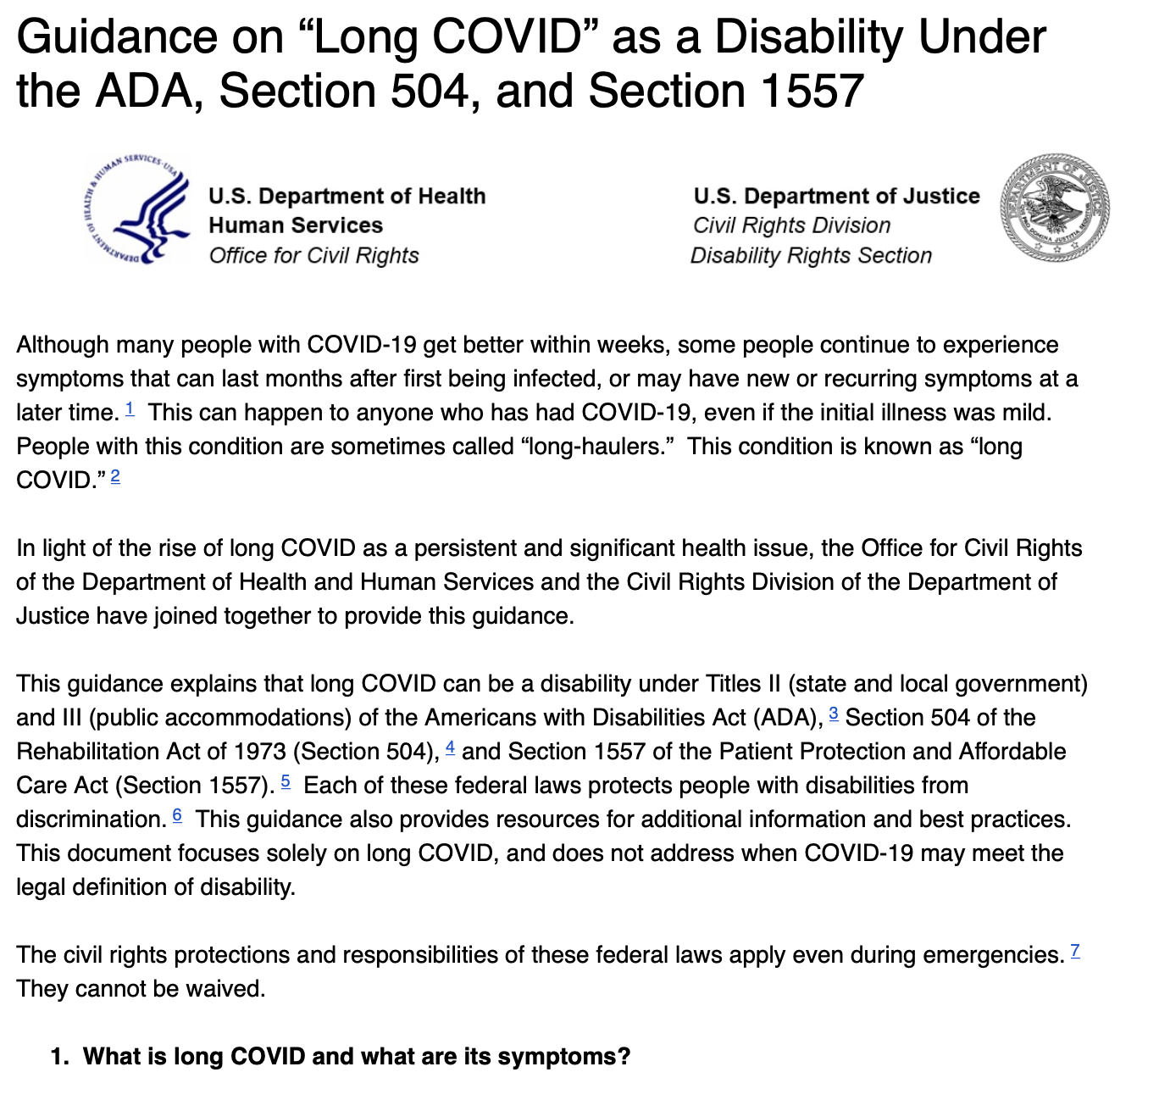
PCC is a Disability Under the ADA

Slide 44

Return to work
Ask about work requirements
  Job
  Typical work day?
  Number of hours? Shifts?
  Physical requirements?
  Screen time

Slide 45
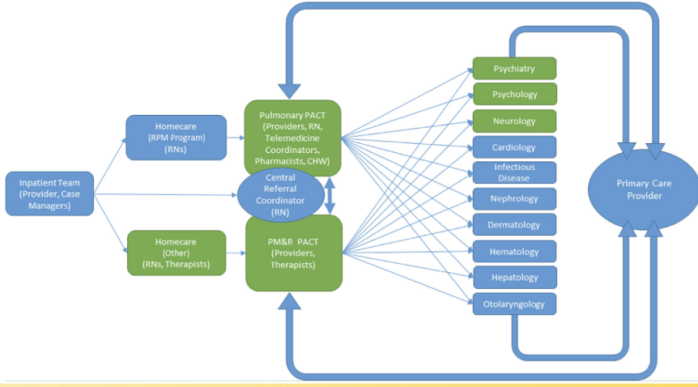
JHU PACT Clinic
Established April 7, 2020
Telemed/In-person Hybrid
JH PACT-ICU:
  Severe COVID-19
JH PACT-Base:
  Mild to moderate COVID-19

Slide 46
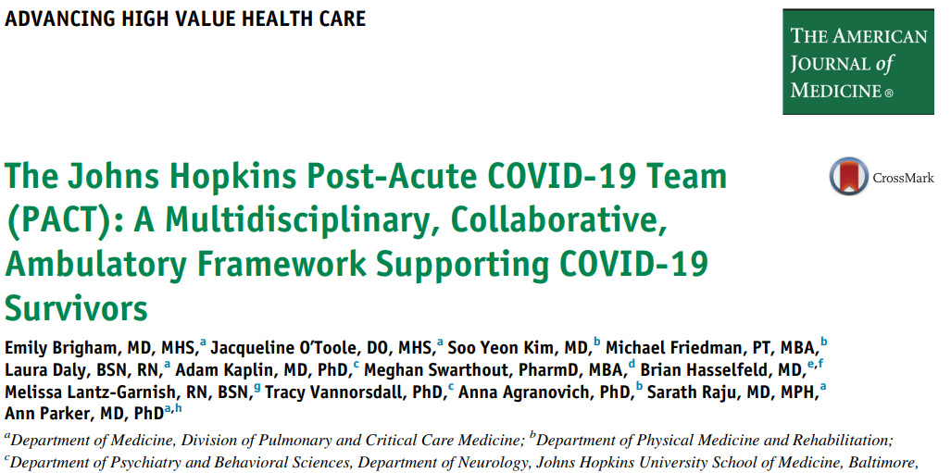
JHU PACT Clinic
Established April 7, 2020
Telemed/In-person Hybrid
JH PACT-ICU:
  Severe COVID-19
JH PACT-Base:
  Mild to moderate COVID-19

Slide 47
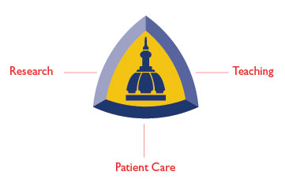
Patient Care
1,358 patients from 16 states
(6,279 visits PM&R and PCCM)
30% reduction in readmissions
(16% → 11%)
Research
Biorepository/registry
RECOVER/ACTIV-6
NIH (NIA, NCATS/N3C)
PCORI
Industry
Education
Dissemination: Lancet, Chest
Leadership: AAPMR, WHO, NIH, CDC
Media: WaPo, NYT, NPR
Notes:
Ann to review accomplishments according to tripartite mission

Slide 48

Future Directions
Clinical Trials
  Autonomic Dysfunction
  Cognitive Dysfunction
  Exercise Intolerance and fatigue
  Sleep Disturbance
  Viral Persistence (RECOVER-VITAL)

Slide 49
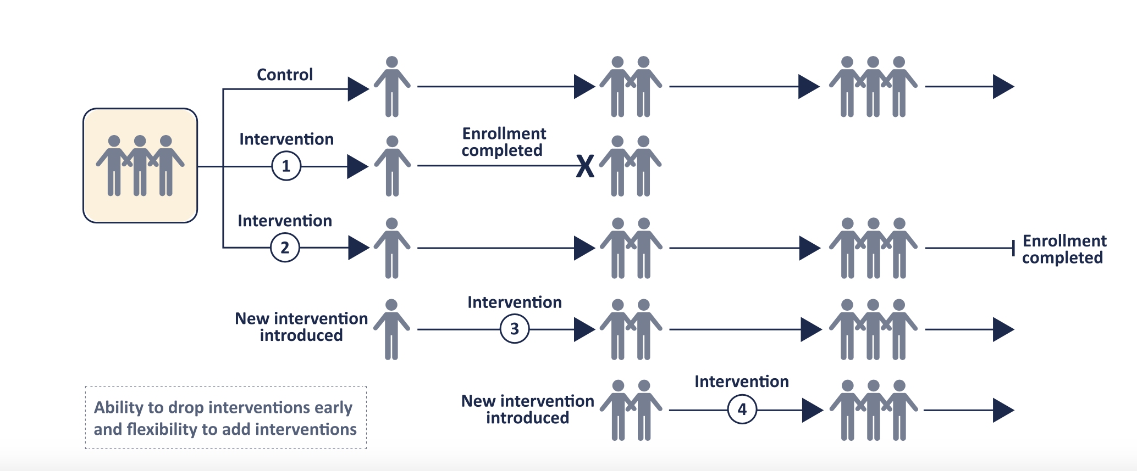
Platform Studies

Slide 50
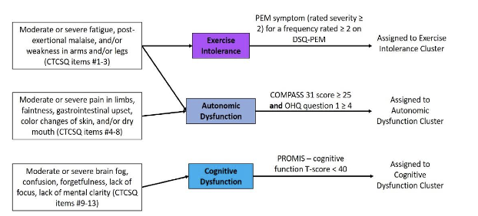
RECOVER VITAL subgroups

Slide 51
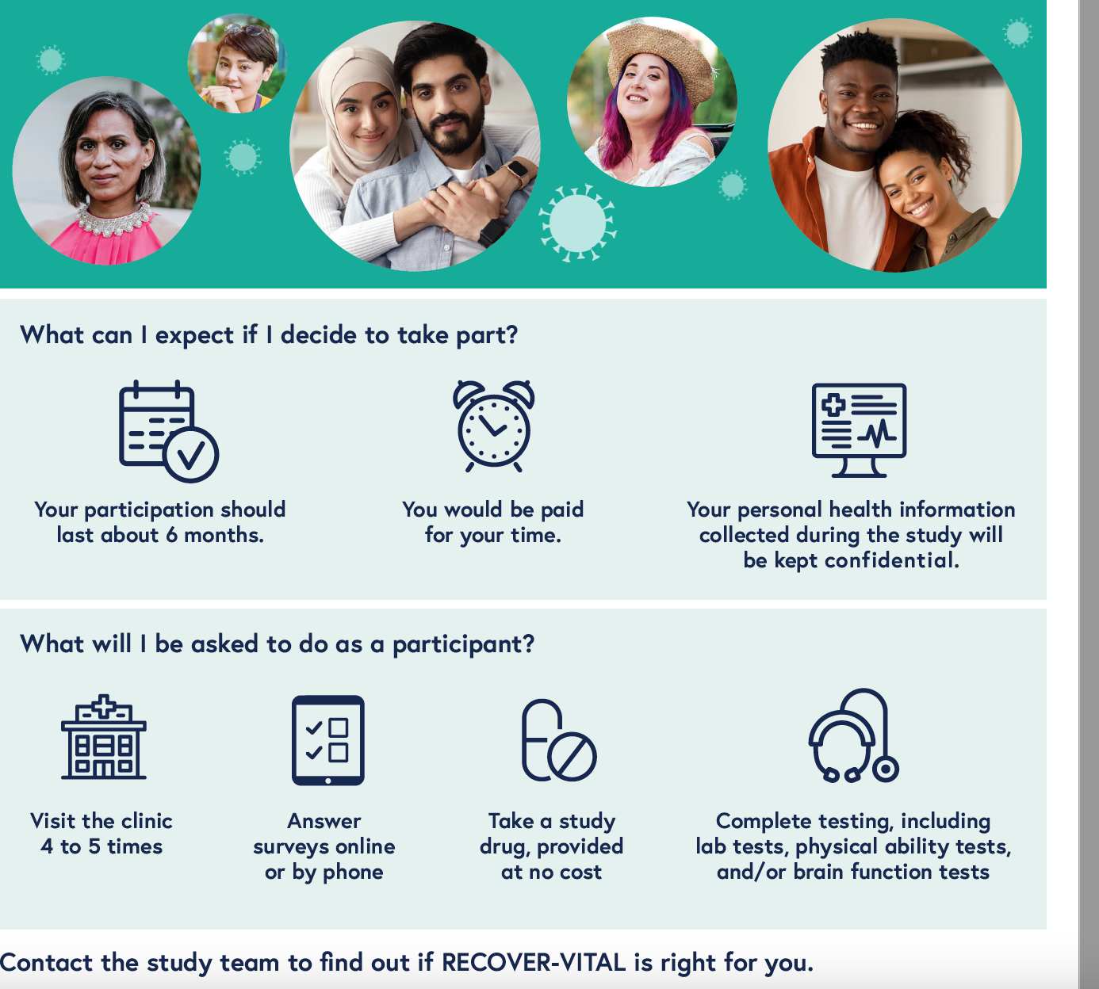
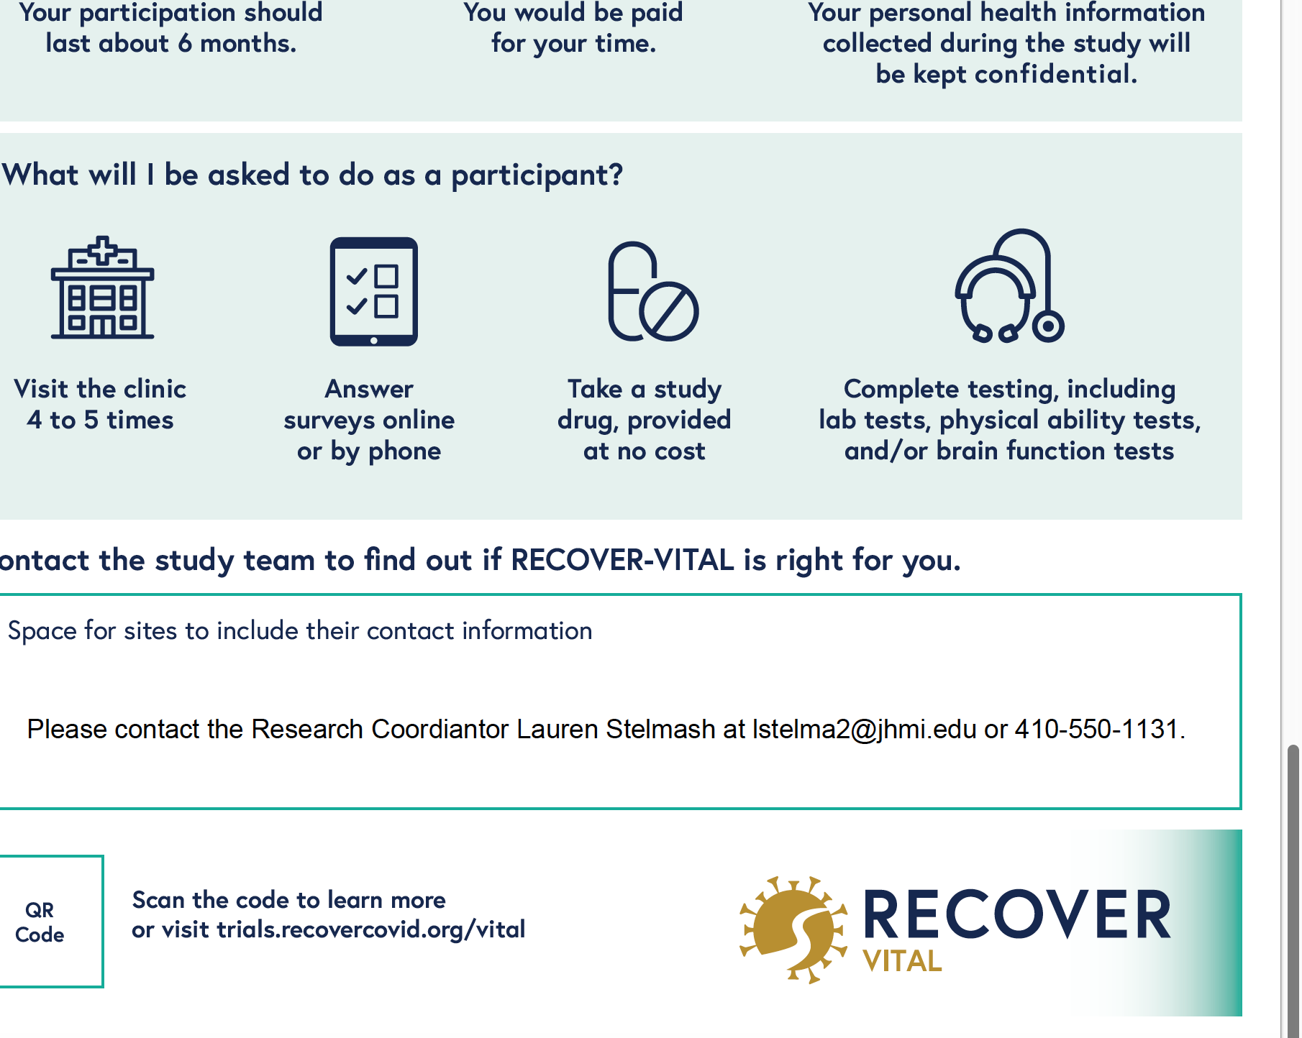
Patient Information

Slide 52

Conclusions
PCC is less common than in initial phases of pandemic but still prevalent
Economic impact is substantial
Evaluate for PCC, and try to help patients maintain QOL, family and work
Refer to clinical trials and PCC clinics

Slide 53






Thank you!
Dr. Tracy Vannnorsdall
Dr. Tae Chung
Dr. Alba Azola
Dr. Ann Parker
Patients and Providers who have generously shared their stories, data and time

Slide 54
Questions?
kgebo@jhmi.edu

Slide 55
CME questions
The prevalence of Post COVID conditions between March 2020 and present has
  1. increased
  2. remained the same
  3. has decreased
PCC is considered a disability under the ADA
  True or False

