Slide 1
Respiratory Syncytial Virus: An update for Internal Medicine Physicians
Shmuel Shoham M.D
Professor of Cilnical Medicine
Johns Hopkins University School of Medicine
Baltimore, MD

Slide 2
Disclosures
research funding from Ansun, F2G, Zeteo and has served as a paid advisor to Pfizer, Scynexis, Immunome, Adamis and Karius
During this lecture, I may discuss the used of medications for both FDA-approved and non-approved indications.

Slide 3
Learning Objectives
Understand the epidemiology and clinical impact of RSV in an elderly population
Understand the mechanism of action of RSV vaccines and data regarding their efficacy and safety
Be able to have effective conversations with elderly people regarding pros and cons of RSV vaccination

Slide 4
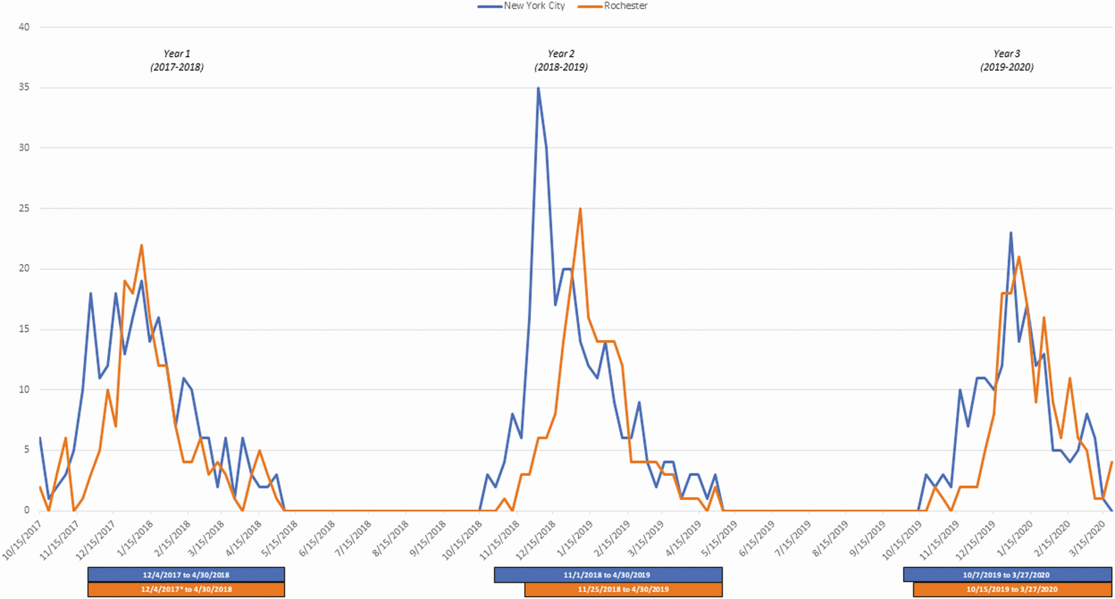
RSV Basics
Two subtypes: A and B
Spread is via large droplets
Direct spread, through contamination of surfaces
Period of contagiousness is about a week. Could be longer for immunocompromised people
Jung HE, et al. Viruses. 2020;12(1):102. CDC. RSV Transmission. https://www.cdc.gov/rsv/about/transmission.html. French CE, et al. Influenza Other Respir Viruses. 2016;10(4):268-290
Battles MB, McLellan JS. Nat Rev Microbiol. 2019;17(4):233-245, Branche Clin Infect Dis, Volume 74, Issue 6, 15 March 2022

Slide 5
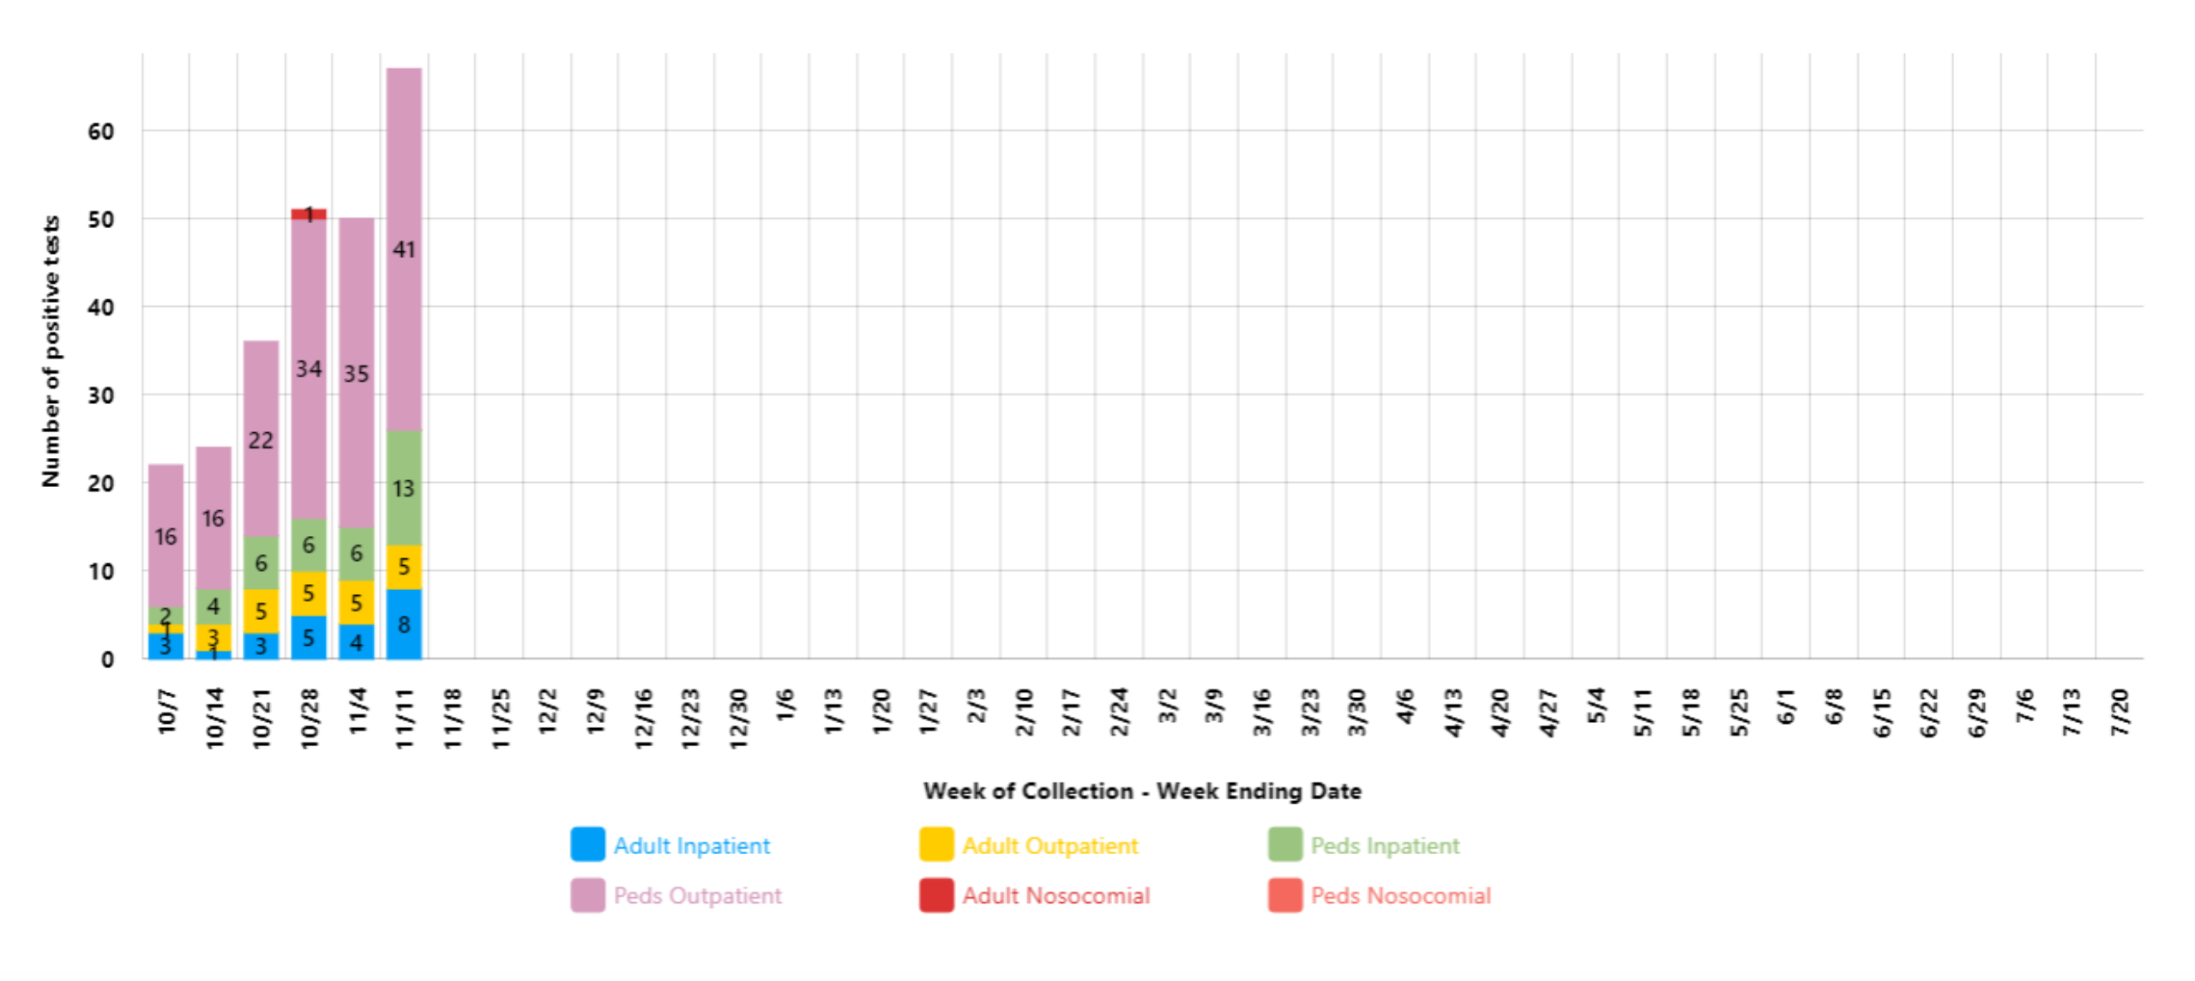
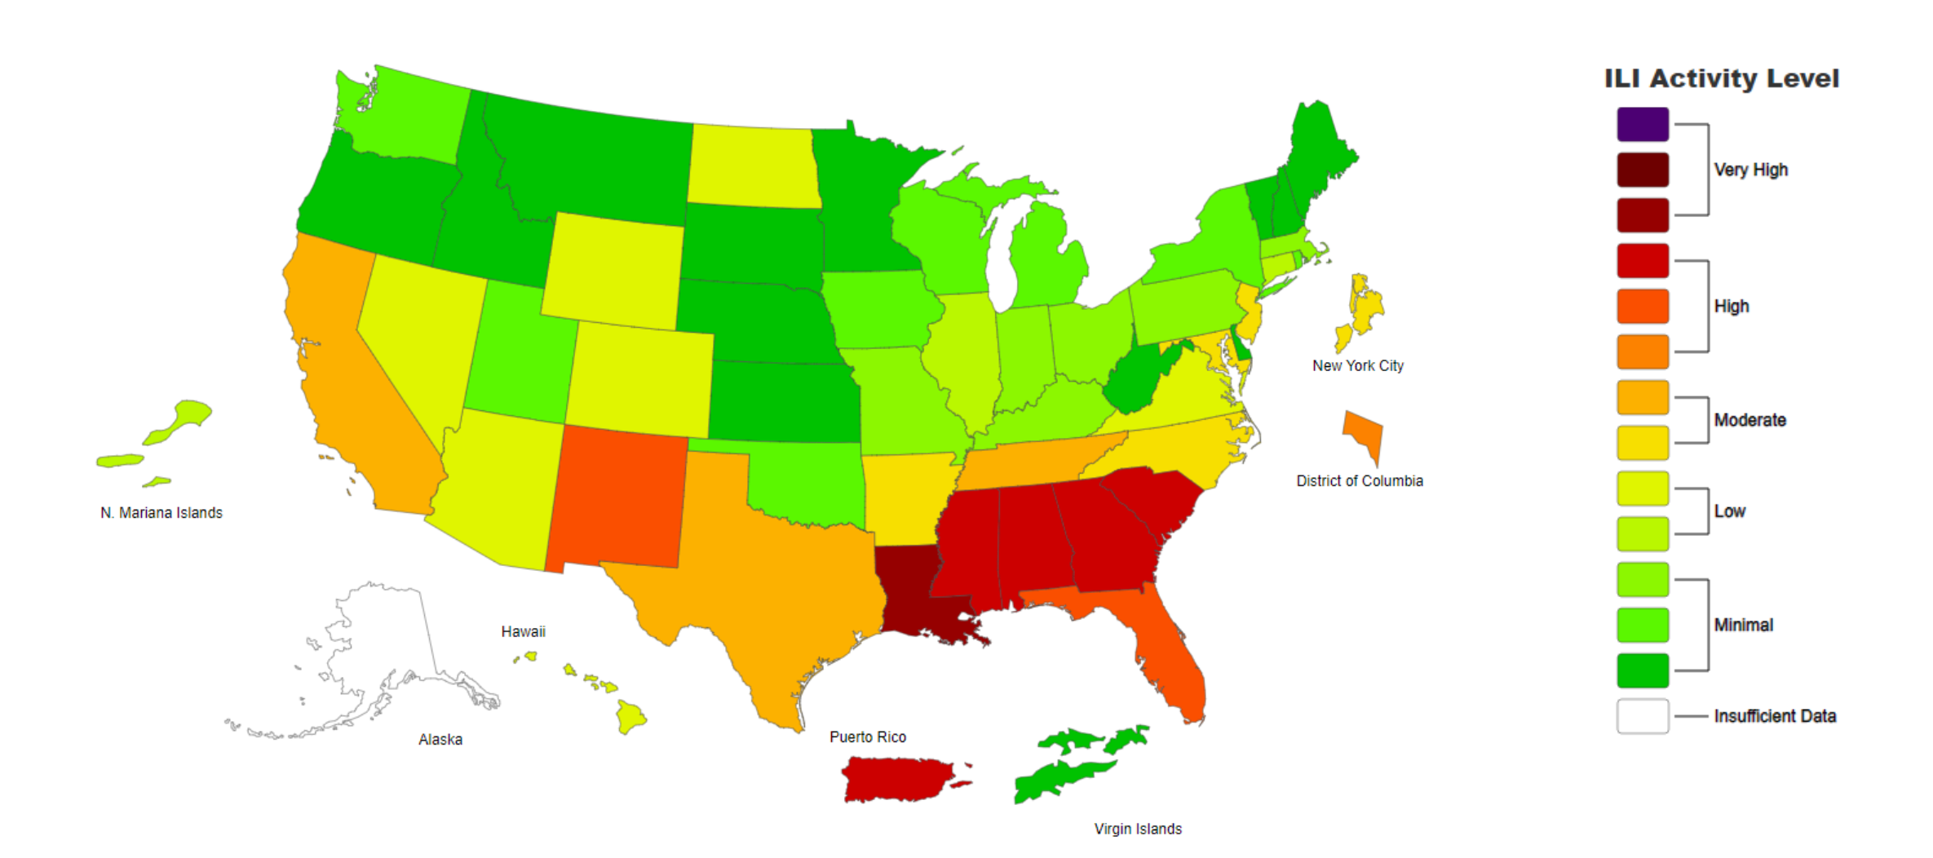
RSV 2023

Slide 6
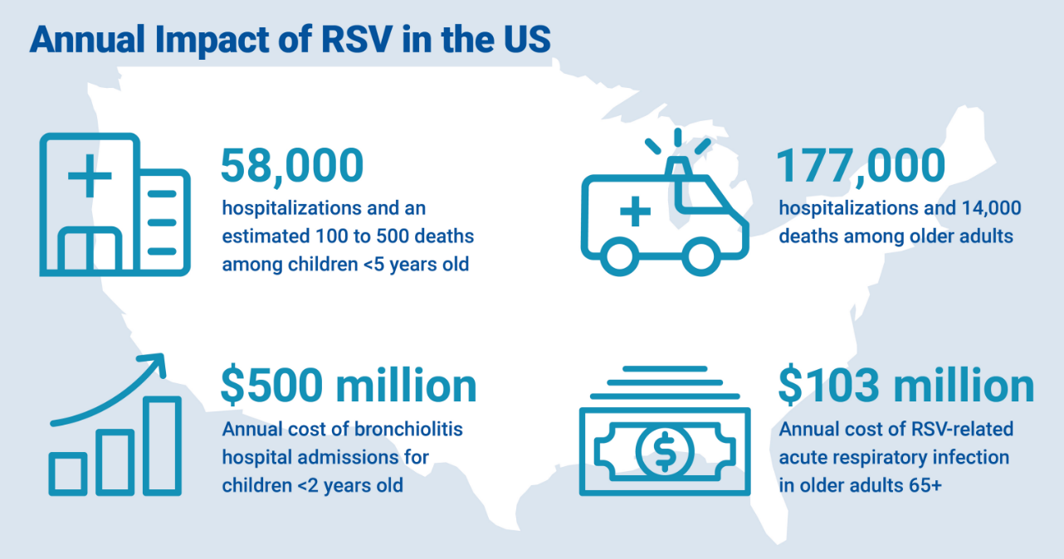
RSV Impact
Every year in the United States, RSV leads to:
~2.1 million outpatient visits and ~58,000 hospitalizations among children <5 years old¹⁻³
~177,000 hospitalizations (third most common reason) and ~14,000 deaths among adults >65 years old^{4,5}
1. Hall CB et al. New Engl J Med. 2009;360(6):588–98. 2. Rha B et al. Pediatrics. 2020;146(1):e20193611. 3. McLaughlin JM et al. JID. 2022;225(6):1100-1111. 4. Branche AR et al. CID. 2022;74(6):1004-1011. 5. Hansen CL et al. .JAMA Network Open. 2022;5(2):e220527

Slide 7
RSV Hospitalizations Among Adults
Average length of stay: 3 to 6 days
Mortality: 6% to 8%
Among those hospitalized
10% to 31% require intensive care
3% to 17% require mechanical ventilation
Historically, some mortality due to RSV might have been attributed to influenza
Colosia AD, et al. PLoS One. 2017;12(8):e0182321. Nam H, Ison M. BMJ. 2019;366:l5021. Prasad N, et al. Clin Infect Dis. 2021;73(1):e158-e163.

Slide 8
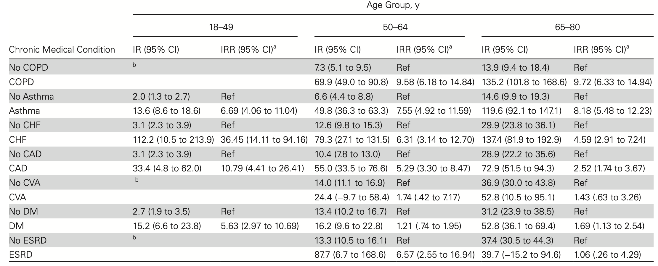
Impact by comorbid condition
Incidence Rates per 100 000 and Incidence Rate Ratios of Respiratory Syncytial Virus Hospitalizations by Age Group and Chronic Medical Condition, Auckland New Zealand, 2012–2015, Adjusted for Ethnicity and Age
Prasad et al CID 2021

Slide 9
Study of RSV Incidence in Elderly Populations
Study Population:
608 healthy adults
540 high-risk adults
1388 hospitalized adults
Results
Influenza identified in 44 prospective and 154 hospitalized patients
RSV: Identified in 102 patients in the prospective cohorts and 142 hospitalized patients
RSV developed annually in 3% to 7% of healthy adults and in 4% to 10% of high-risk adults
Among healthy elderly patients, RSV infection generated fewer office visits than influenza; however, the use of health care services by high-risk adults was similar in the two groups.
In the hospitalized cohort, RSV infection and influenza A resulted in similar lengths of stay, rates of use of intensive care and mortality
Falsey AR et al. N Engl J Med. 2005;352(17):1749-1759.
Notes:
Respiratory Syncytial Virus Infection in Elderly and High-Risk Adults
List of authors.
Ann R. Falsey, M.D., Patricia A. Hennessey, R.N., Maria A. Formica, M.S., Christopher Cox, Ph.D., and Edward E. Walsh, M.D.
Article
Figures/Media
38 References
1213 Citing Articles
Abstract
BACKGROUND
Respiratory syncytial virus (RSV) is an increasingly recognized cause of illness in adults. Data on the epidemiology and clinical effects in community-dwelling elderly persons and high-risk adults can help in assessing the need for vaccine development.
METHODS
During four consecutive winters, we evaluated all respiratory illnesses in prospective cohorts of healthy elderly patients (≥65 years of age) and high-risk adults (those with chronic heart or lung disease) and in patients hospitalized with acute cardiopulmonary conditions. RSV infection and influenza A were diagnosed on the basis of culture, reverse-transcriptase polymerase chain reaction, and serologic studies.
RESULTS
A total of 608 healthy elderly patients and 540 high-risk adults were enrolled in prospective surveillance, and 1388 hospitalized patients were enrolled. A total of 2514 illnesses were evaluated. RSV infection was identified in 102 patients in the prospective cohorts and 142 hospitalized patients, and influenza A was diagnosed in 44 patients in the prospective cohorts and 154 hospitalized patients. RSV infection developed annually in 3 to 7 percent of healthy elderly patients and in 4 to 10 percent of high-risk adults. Among healthy elderly patients, RSV infection generated fewer office visits than influenza; however, the use of health care services by high-risk adults was similar in the two groups. In the hospitalized cohort, RSV infection and influenza A resulted in similar lengths of stay, rates of use of intensive care (15 percent and 12 percent, respectively), and mortality (8 percent and 7 percent, respectively). On the basis of the diagnostic codes of the International Classification of Diseases, 9th Revision, Clinical Modification at discharge, RSV infection accounted for 10.6 percent of hospitalizations for pneumonia, 11.4 percent for chronic obstructive pulmonary disease, 5.4 percent for congestive heart failure, and 7.2 percent for asthma.
CONCLUSIONS
RSV infection is an important illness in elderly and high-risk adults, with a disease burden similar to that of nonpandemic influenza A in a population in which the prevalence of vaccination for influenza is high. An effective RSV vaccine may offer benefits for these adults.
Respiratory syncytial virus (RSV) was first recognized in 1957 as a cause of bronchiolitis in infants and is the most commonly identified cause of lower respiratory tract infection in young children.1 Mild illness in young adults with reinfection was described and confirmed in subsequent family studies.2,3 However, RSV was not recognized as a potentially serious problem in older adults until the 1970s, when outbreaks of the virus occurred in long-term care facilities.4-7 Since then, additional studies in hospitalized adults have suggested that RSV may be an important cause of illness in community-dwelling elderly people.8,9 Most previous studies used insensitive viral culture or retrospective serologic studies for diagnosis, a practice that led to widely variable assessments of the incidence and effects of the disease. Recent estimates of the disease burden of RSV in adults have been based on mathematical models linking viral activity in children with hospitalization and death in adults,10-14 and Thompson et al. have estimated that RSV accounts for approximately 10,000 deaths annually in the United States in persons over the age of 65 years.14 Although these estimates are useful, their accuracy is confounded by cocirculation of other respiratory viruses with indistinguishable clinical syndromes and is limited by the assumption that viral activity in infants reflects events in elderly populations.15-17 These results have stimulated interest in vaccines and other treatments for RSV in adults.15,18,19 However, additional data regarding virus-specific epidemiology and disease effects, particularly in community-dwelling elderly persons and high-risk adults, are needed before embarking on costly vaccine trials.
Therefore, we identified RSV infections during four consecutive winters in prospective cohorts of community-dwelling elderly people and high-risk adults and in persons hospitalized with acute cardiopulmonary conditions. Identical techniques of diagnosing RSV infection and influenza A were used to assess the disease burden and to provide a direct comparison of RSV infection with influenza A, which is a universally recognized cause of serious disease in the populations mentioned above.
Methods
STUDY DESIGN
The study spanned four consecutive winters, from late 1999 through early 2003 in Rochester, New York. Three groups of patients were recruited: two prospective cohorts (healthy elderly persons and high-risk adults) and a hospitalized cohort of patients who were admitted each winter with cardiopulmonary illnesses. Enrollees or their guardians provided written informed consent. The University of Rochester Research Subjects Review Board and the Rochester General Hospital Clinical Investigation Committee approved the study.
ENROLLMENT OF PROSPECTIVE COHORTS
Persons who were 65 years of age or older and did not have disabling underlying illnesses (i.e., healthy elderly persons) and persons 21 years of age or older with physician-diagnosed congestive heart failure or chronic pulmonary disease (i.e., high-risk adults) were enrolled in the late summer and fall (from July 15 to November 15) and were followed for a maximum of two winters. To be considered high risk, patients with cardiac disease were required to have at least class II symptoms according to the New York Heart Association's classification, and patients with pulmonary disease were required to have activity-restricting symptoms or use long-term medications.20 Advertisements and mailings were used to recruit patients from health maintenance organizations and from cardiac and pulmonary rehabilitation programs.
At enrollment, data on the patients' demographic status, medical history, and functional performance were recorded. Functional status was assessed with the use of a modified Katz Activities of Daily Living (ADL) Scale and the Instrumental Activities of Daily Living (IADL) Scale.21,22 Baseline blood samples were collected from the prospective groups before the RSV season (from July 15 to November 15) and postseason blood samples were collected the following spring (from April 15 to June 15).
ILLNESS EVALUATION
Prospective Cohorts
Patients notified study personnel regarding symptoms of respiratory illness or worsening of baseline cardiopulmonary symptoms from November 15 through April 15 of each year. Symptoms included nasal congestion, sore throat, hoarseness, new or worsening cough, sputum production, and dyspnea with or without fever. During home visits, investigators conducted a physical examination, collected nasopharyngeal swabs and blood samples, and obtained a history of the illness. Four to six weeks later, patients were questioned about their functional status and use of health care services (including telephone consultations, office visits, emergency room visits, and hospitalizations). Events related to the use of health care services were recorded as unique if the events were isolated, whereas the highest level of care was counted if the events were directly related.
Hospital Cohort
During the same surveillance periods, all adults 65 years of age or older or with underlying cardiopulmonary diseases who were admitted to Rochester General Hospital with acute respiratory symptoms were evaluated within 48 hours after admission. Enrollment was performed Monday through Friday, so patients who were admitted on Friday were not eligible. Patients with admission diagnoses of pneumonia (International Classification of Diseases, 9th Revision, Clinical Modification [ICD-9-CM] codes 480 to 486), upper respiratory infection (ICD-9-CM code 465), bronchitis (ICD-9-CM code 466), influenza (ICD-9-CM code 487), chronic obstructive pulmonary disease (ICD-9-CM codes 490 to 492 and 496), asthma (ICD-9-CM code 493), viral illness (ICD-9-CM code 79.9), or congestive heart failure (ICD-9-CM code 428) were eligible and underwent identical evaluations as prospective cohorts. Patients' functional activity scores before their illness were determined by a review of records of social workers and nurses plus interviews with patients and their families. Patients were followed until discharge from the hospital. Follow-up visits were made at home or in the hospital four to six weeks after the initial assessment to collect data on functional activity and convalescent-phase blood samples.
LABORATORY STUDIES
Samples from nasopharyngeal swabs were inoculated into tubes of HEp-2 cells and rhesus monkey kidney cells within four hours after collection, and the remainder were frozen at –80°C. Cultures were examined daily for cytopathic effects in the clinical microbiology laboratory, and viral growth was confirmed by indirect immunofluorescence with the use of monoclonal antibodies specific for RSV and influenzavirus A and B.
Reverse-transcriptase polymerase chain reaction (RT-PCR) for RSV and influenza was performed on 250-μl aliquots of samples from nasopharyngeal swabs with the use of single-tube nested reactions with primers from the conserved region of the RSV fusion and influenza A matrix genes.23,24 The limit of detection for each assay was 0.1 plaque-forming unit.25 RSV subgroups A and B were identified by a strain-specific RT-PCR assay.26
Enzyme immunoassay was used to measure serum IgG responses to purified RSV glycoproteins according to established methods.27 The serum IgG responses to influenza A and B antigens were determined with the use of whole-cell lysate assays infected with influenzavirus, as previously described.24,28 An increase by a factor of four or more in the IgG titer in response to any RSV antigen or influenza antigen was considered diagnostic.
DEFINITIONS OF ILLNESS
Symptomatic RSV or influenza infections were defined as illnesses with a positive viral culture, a positive RT-PCR assay, or a diagnostic serologic result. Asymptomatic RSV infection was defined as an increase by a factor of four or more in RSV IgG titers in samples obtained after the winter season as compared with those obtained before the winter season in persons without illness or in asymptomatic intervals between illnesses. Interpretation of the serologic results was occasionally complicated by vaccination. During the four years of the study, the timing of influenza vaccination was highly variable because of vaccine shortages or delays. For illnesses that occurred within four weeks after vaccination, the antibody response alone was not sufficient to define influenza infection. Asymptomatic influenza infection was defined as an antibody rise occurring more than four weeks after vaccination during an illness-free interval.
STATISTICAL ANALYSIS
The chi-square test and Fisher's exact test were used to compare proportions. For data with a normal distribution, means were compared with Student's t-test; for skewed data, the Mann–Whitney test was used. The Poisson regression model and McNemar's test were used to compare the rates of illness and viral infection.29
Results
POPULATIONS
A total of 608 healthy elderly persons and 540 high-risk adults were enrolled in the prospective surveillance. During the same period, 1483 hospitalized patients were eligible for study, of whom 1388 (94 percent) agreed to participate. Demographic characteristics and admission diagnoses were not significantly different for those who declined to participate in the study.
Table 1.
Characteristics of the Study Cohorts.
Characteristics of the study populations are summarized in Table 1. The average age in each group was at least 70 years. Of the high-risk patients, 73 percent were 65 years of age or older, 17 percent were between the ages of 55 and 64 years, and 10 percent were 54 years of age or younger. The percentage of persons with exposure to children was higher in the high-risk group than in either the healthy elderly group or the hospitalized group (P=0.008), although living situations were similar for the three groups (Table 1). There were significantly lower rates of chronic disease and the use of medication in the healthy elderly cohort than in the high-risk and hospitalized groups. Despite having substantial cardiopulmonary disease, the high-risk group was only slightly less functional than the healthy elderly group. In contrast, the hospitalized group had significantly worse functional scores before hospitalization than did both prospective cohorts (P<0.001).
ILLNESSES
During the four winter seasons studied, 2514 cases of illness were evaluated (1043 in prospective patients and 1471 in hospitalized patients). Although the numbers of illnesses in the two prospective groups were similar, rates expressed as cases of illness per 100 person-months were higher in high-risk subjects than in healthy elderly patients because of a greater attrition rate (14.3 cases vs. 10.4, P<0.001; relative risk, 1.39; 95 percent confidence interval, 1.23 to 1.57).
Table 2.
Rates of Illness and Infection According to Year of Study.
During the four winters, the activity of both influenzavirus A and B varied considerably, whereas annual RSV activity was relatively constant (Table 2). The circulating influenzavirus strains varied considerably during the years of study.30 The 1999–2000 season was dominated by influenzavirus A H3N2 (99.5 percent) in the mid-Atlantic region. During subsequent years, the circulating strains were as follows: 2000–2001, 37 percent influenzavirus A (97 percent H1N1) and 63 percent influenzavirus B; 2001–2002, 88 percent influenzavirus A (98 percent H3N2) and 12 percent influenzavirus B; 2002–2003, 86 percent influenzavirus A (70 percent H1N1) and 14 percent influenzavirus B.
RSV infection was identified in 102 cases of illness involving patients in the prospective cohorts and in 142 cases involving hospitalized patients. Influenza A was diagnosed in 44 cases of illness involving patients in the prospective cohorts and in 154 cases involving hospitalized patients (Table 2). Given the low number of influenza B infections, subsequent discussion will be limited to influenza A and RSV infection. RSV infection developed annually in 3 to 7 percent of the healthy elderly group and in 4 to 10 percent of the high-risk group. There was no significant difference in the rates of RSV infection or influenza A among patients in their first year of surveillance as compared with their second year. Two patients in the prospective cohorts had two cases of RSV infection each, and four patients had influenza A and RSV infection at different times. The number of patients with RSV infection in the prospective cohorts was approximately twice that of patients with influenza A (97 vs. 39, P<0.001). There were 1.5 RSV infections per 100 person-months in the high-risk group and 0.9 in the healthy elderly group (P=0.02; relative risk, 1.61; 95 percent confidence interval, 1.09 to 2.39). Influenza A rates were identical in the two prospective cohorts: 0.5 infection per 100 person-months. Despite higher rates of RSV infection in the prospective cohorts, the overall numbers of patients who had RSV infection and influenza in the hospital cohort were similar. Data on the hospital cohort do not include those for patients from the prospective cohorts who were subsequently admitted to the hospital.
VIRAL DIAGNOSIS
Table 3.
Diagnostic Tests.
Most illnesses (76 percent) were evaluated with all three diagnostic methods (Table 3). Serum from convalescent patients was not available in 18 percent of cases, and nasal specimens were unobtainable in 6 percent. RSV infection was diagnosed with more than one test in 47 percent of cases, RT-PCR alone was used in 20 percent, and serologic testing alone was used in 33 percent. Eleven hospitalized patients had dual infections and were excluded from clinical analyses (nine patients with both RSV infection and influenza A, one with RSV infection and influenza B, and one with influenza A and influenza B). The RSV strain was group A in 73 cases (45 percent) and group B in 89 (55 percent). Both RSV strains circulated each year without significant differences in the percentages of group A and B viruses among mildly ill outpatients and severely ill hospitalized patients.
CLINICAL EFFECTS OF INFECTION IN PROSPECTIVE COHORTS
Eighty-nine percent of RSV infections were symptomatic in the prospective cohorts. Five patients in the healthy elderly group and six patients in the high-risk group had serologic evidence of infection without reported illnesses. Similarly, 91 percent of patients with influenza were symptomatic. The symptoms and signs of RSV infection and those of influenza were not substantially different (data not shown).
Table 4.
Infections in Healthy Elderly Patients and High-Risk Patients.
The effects of RSV infection were considerable in both the healthy elderly group and the high-risk group (Table 4). Fifteen percent of patients in the healthy elderly group called their physician and 17 percent made office visits, although none of them required emergency room or inpatient services. The use of medical care was significantly greater in the high-risk group: 23 percent called the doctor, 29 percent made office visits, 9 percent visited the emergency room, and 16 percent required hospitalization. Two high-risk patients with RSV infection (4 percent) died. The mean duration of illness was approximately two weeks in both groups, and 39 percent of patients in the healthy elderly group and 45 percent in the high-risk group were unable to perform the normal activities of daily living for at least one day. The proportion of patients with acute functional impairment was substantially greater in the high-risk group with RSV infection than in the healthy elderly group.
Among the healthy elderly patients, influenza A infection generated a greater percentage of office visits than did RSV infection (42 percent vs. 17 percent, P=0.04) and a higher rate of antibiotic use (33 percent vs. 9 percent, P=0.02). Among high-risk patients, the use of medical care was similar in the RSV and influenza A subgroups, although office visits were more common in the influenza A subgroup (60 percent vs. 29 percent, P=0.02). However, because RSV infection occurred more frequently than influenza A, the total number of health care visits (office visits, emergency room visits, and hospitalizations) was similar for the two viruses, at 38 and 30, respectively. Acute functional impairment in the healthy elderly group was also greater with influenza than it was with RSV infection, with 67 percent of patients housebound (P=0.005) and 25 percent confined to bed (P=0.05). None of the patients in the healthy elderly group with influenza were hospitalized or died, whereas 20 percent of high-risk patients were hospitalized.
CLINICAL EFFECTS OF INFECTION WITH RSV AND INFLUENZA A IN HOSPITALIZED PATIENTS
Table 5.
Illnesses in Hospitalized Patients.
Demographic and clinical characteristics of patients with RSV infection and patients with influenza requiring hospitalization were not significantly different (Table 5). Twelve percent of patients with RSV infection and 10 percent of patients with influenza were residents of long-term care facilities, a finding that was similar to that of the hospital cohort in general (8 percent). The clinical effects of RSV infection and influenza in the hospitalized cohorts were also similar, as assessed by the length of stay; whether the patient had pneumonia, was in intensive care, or required mechanical ventilation; and mortality. The mortality among patients with RSV infection was higher in the group admitted from long-term care facilities (38 percent) than in the group admitted from the community (3 percent, P<0.001), whereas among patients with influenza, there was no significant difference between the two groups. Five percent of patients with RSV infection and 6 percent of patients with influenza required a higher level of care at discharge than at admission. The mean IADL functional scores increased slightly after hospitalization for patients with RSV infection (4.1±4.1 to 4.9±4.0), and a similar trend was observed among patients with influenza. Overall, according to the diagnosis at discharge, RSV infection accounted for 10.6 percent of hospitalizations for pneumonia, 11.4 percent for chronic obstructive pulmonary disease, 5.4 percent for congestive heart failure, and 7.2 percent for asthma.
Discussion
This four-year prospective, diagnosis-specific study firmly documents that RSV is an important pathogen in elderly and high-risk adults. Although pediatricians are keenly aware that RSV may cause serious illness in their patients, most internists are less aware of RSV. Given the difficulty with diagnosis in clinical practice and the lack of treatment, this lack of awareness is understandable. However, from a public health perspective, our study shows the substantive disease burden associated with this virus and validates the results of earlier, mathematically derived estimates.
Diagnosis by nested RT-PCR allowed a precise determination of the rates of RSV infection that had not previously been possible. In addition, the use of RT-PCR in this study strengthens the causal link between RSV infection and hospitalization, which can be questioned in serologically based studies. In our study, 61 percent of patients who had an increase in antibodies to RSV also had a positive RT-PCR assay, a finding suggesting that infection occurred shortly before admission. Conversely, since 83 percent of patients with a positive PCR assay for RSV whose serum was tested during convalescence had an immune response, it is unlikely that detectable viral RNA reflects transient colonization.
The annual incidence of RSV infection in the prospective cohorts averaged 5.5 percent and was relatively constant during the four years and nearly twice that of influenza A. The rate of RSV infection in this study was higher than the 3 percent observed by Nicholson and colleagues in elderly adults in the United Kingdom and probably reflects our use of RT-PCR and a more sensitive serologic test.31 It must be recognized that the rate of influenza was probably reduced by the high rate of vaccination in our population. Since immunization is estimated to have an efficacy of approximately 50 percent for the prevention of respiratory illness in elderly persons, influenza cases might have been expected to double without vaccination.32
Almost all RSV infections were symptomatic, and they frequently led to acute functional impairment and to the use of health care services. One quarter of all healthy elderly patients had contact with a health care provider during their illness; nearly half of all high-risk patients sought medical attention, and 16 percent were hospitalized. Although influenza resulted in greater use of health care services by healthy elderly patients than did RSV infection, differences between RSV infection and influenza were less distinct in the high-risk group, with a similar number of hospitalizations for each type of infection during the four years. However, the effect of the circulating influenza strain was clearly seen. During years 2 and 4, when the dominant strain was H1N1 (one not associated with substantial morbidity and mortality in the elderly), hospitalizations for RSV infection outnumbered those for influenza.14,33 In contrast, when H3N2 influenza was prevalent, in years 1 and 3, admissions for influenza were two to three times as common as those for RSV infection. This finding is consistent with other data indicating that infection with influenza H3N2 but not H1N1 results in a more severe illness than does RSV infection.14 In addition, the high rate of vaccination for influenza in our community probably affected the rate of hospitalization. The efficacy of vaccination in reducing the rate of hospitalization from influenza is estimated to be 40 to 50 percent.34,35 Sixty-eight percent of patients who were hospitalized with influenza reported having been vaccinated, as compared with 75 percent of those with RSV infection, a finding that suggests a more modest vaccine effect. However, even if the number of influenza cases were doubled, rates of hospitalization for RSV and influenza would not be dramatically different.
Overall, during the study period, RSV infection accounted for 11 percent of hospitalizations for pneumonia, 11 percent for chronic obstructive pulmonary disease, 5 percent for congestive heart failure, and 7 percent for asthma. According to the National Center for Health Statistics of the Centers for Disease Control and Prevention, in 1999 the numbers of discharges from U.S. hospitals of adults 65 years of age or older for the diagnoses of pneumonia, chronic obstructive pulmonary disease, congestive heart failure, and asthma were 1.3 million, 0.76 million, 2.5 million, and 0.35 million, respectively.36 By applying our rates and adjusting by 50 percent for surveillance during the winter months, RSV infection would account for approximately 177,525 admissions each year. On the basis of our study, which showed that the death rate for hospitalized patients with RSV infection was 8 percent, 14,000 annual deaths would be predicted, a number similar to that estimated by Thompson et al.14 Hospitalization costs alone would exceed $1 billion, an estimate not dissimilar to that made by Han et al.37 Outpatient costs would also probably be substantial given our findings and those of Zambon et al., who reported that up to 18 percent of office visits made by elderly adults for respiratory illnesses during winter were RSV-related.38
In addition to bringing RSV to the attention of internists, our study underscores the continuing importance of yearly influenza epidemics in the expanding elderly and high-risk populations. Programs to improve the efficacy of influenza vaccination and to ensure adequate and timely supplies of vaccine should remain a high priority. However, in order to optimize the reduction in the total burden of viral respiratory disease, we must recognize that other pathogens also contribute to the swell of patients in offices and hospitals during the winter months. The results of this study document the importance of RSV infection in adults and confirm the need for the development of an RSV vaccine for high-risk and elderly adults.

Slide 10
Study of Incidence in Elderly Populations
RSV generated fewer office visits than influenza in healthy adults, but results were similar for high-risk adults
For hospitalized patients, there were similar lengths of stay
ICU admission was 15% for RSV and 12% for influenza
Mortality was 8% for RSV and 7% for influenza
RSV accounted for
10.6% of pneumonia admissions
11.4% of COPD exacerbations
5.4% of CHF admissions
7.2% of asthma admissions
Falsey AR et al. N Engl J Med. 2005;352(17):1749-1759. French CE, et al. Influenza Other Respir Viruses. 2016;10(4):268-290.

Slide 11
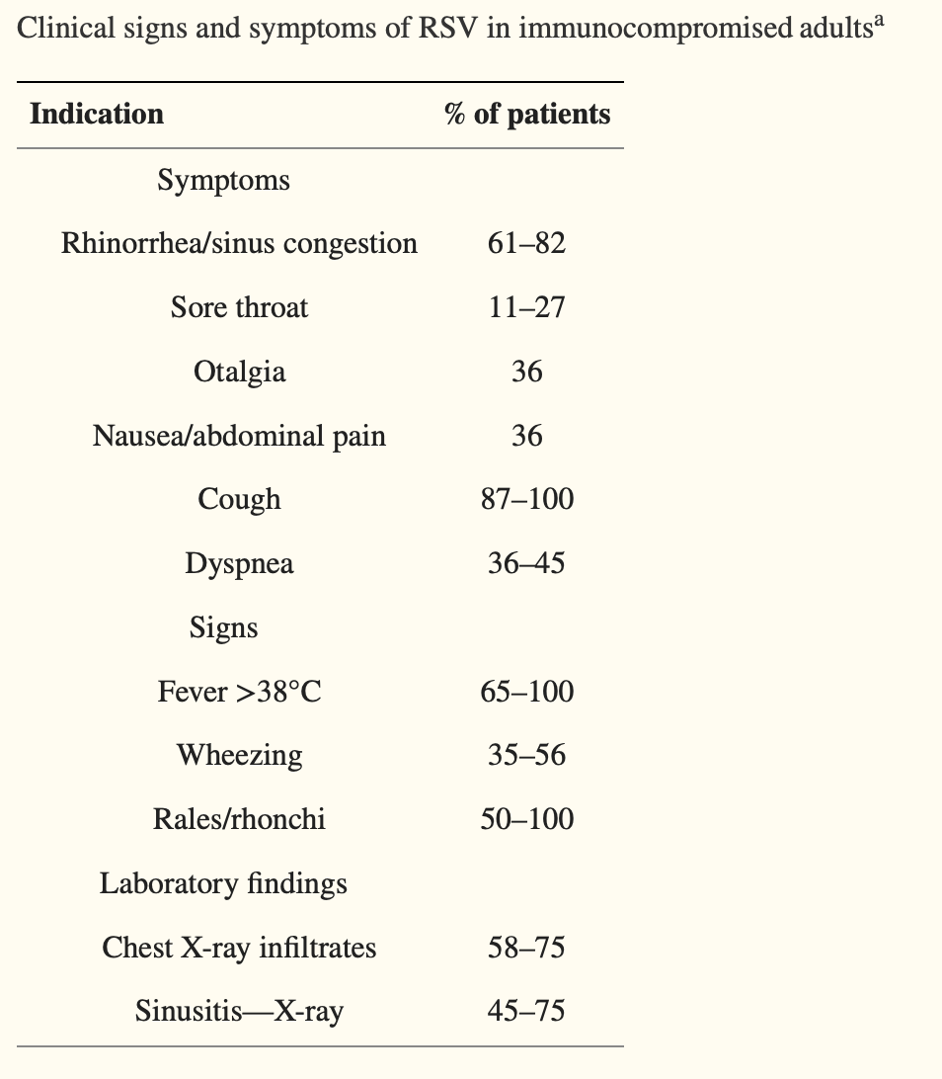
Symptoms of RSV
Falsey Clin Microbiol Rev. 2000

Slide 12
Why Test for RSV?
Clinical Management
Reduce unneeded antibiotic therapy
Reduce further evaluation (ie, bronchitis)
Palivizumab prophylaxis
HEIC planning and screening
Villanueva D-DH, et al. Ther Adv Infect Dis. 2022;9:20499361221091413.
HEIC=hospital epidemiology and infection control

Slide 13
Who To Test
Children hospitalized with acute lower respiratory tract disease
Immunocompromised patients
Immunocompetent patients with recurrent respiratory illnesses
Immunocompetent older adults who are hospitalized with acute lower respiratory tract disease
CDC. RSV for Healthcare Providers. https://www.cdc.gov/rsv/clinical/index.html

Slide 14
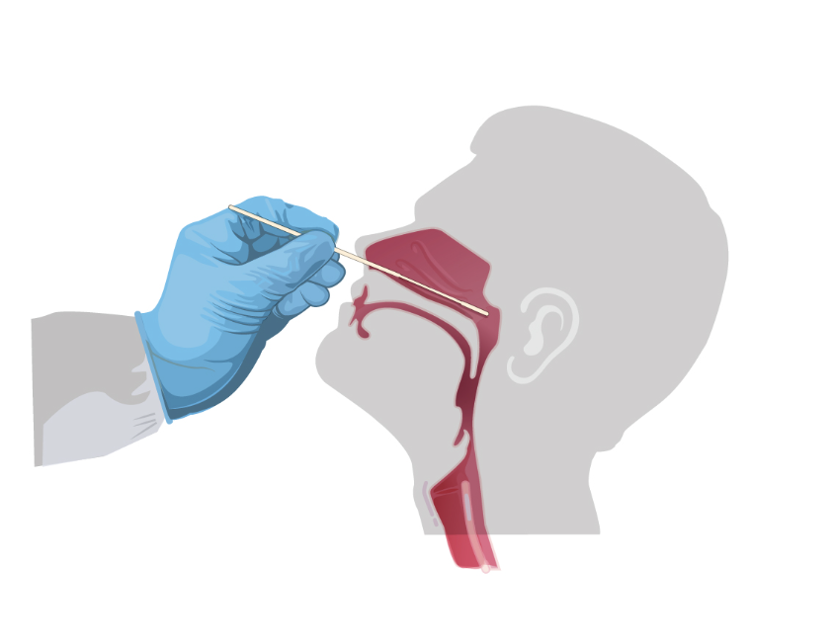
RSV: Get a Good Sample
Increased diagnostic yield with nose and throat combined using flocked swabs
CDC https://www.cdc.gov/coronavirus/2019-ncov/lab/guidelines-clinical-specimens.html

Slide 15
RSV Vaccines for Older Adults

Slide 16
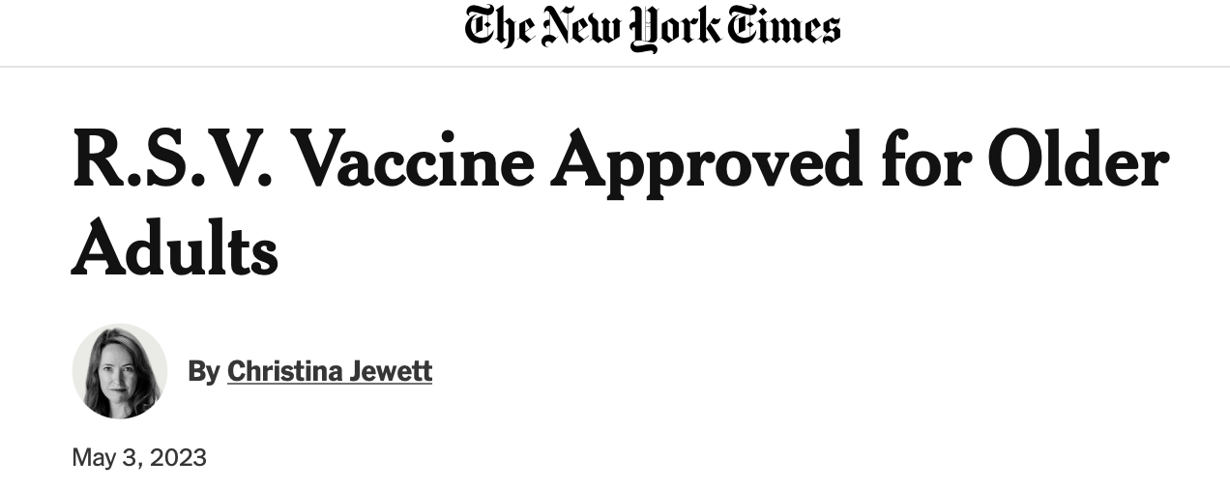
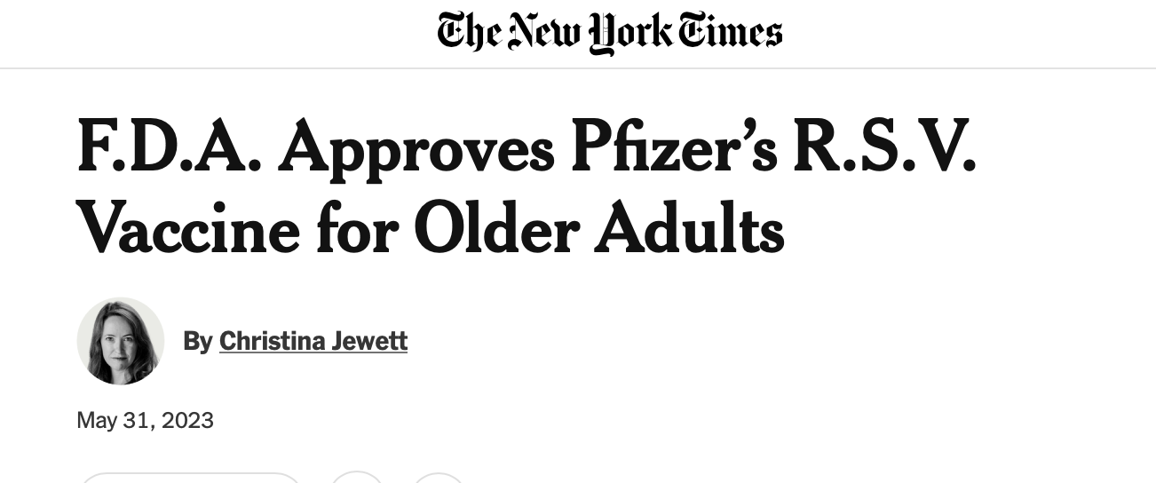
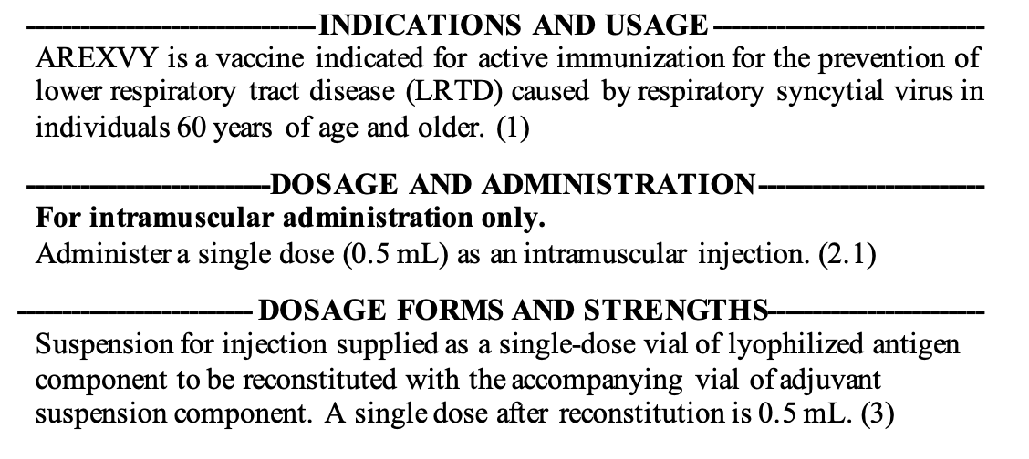
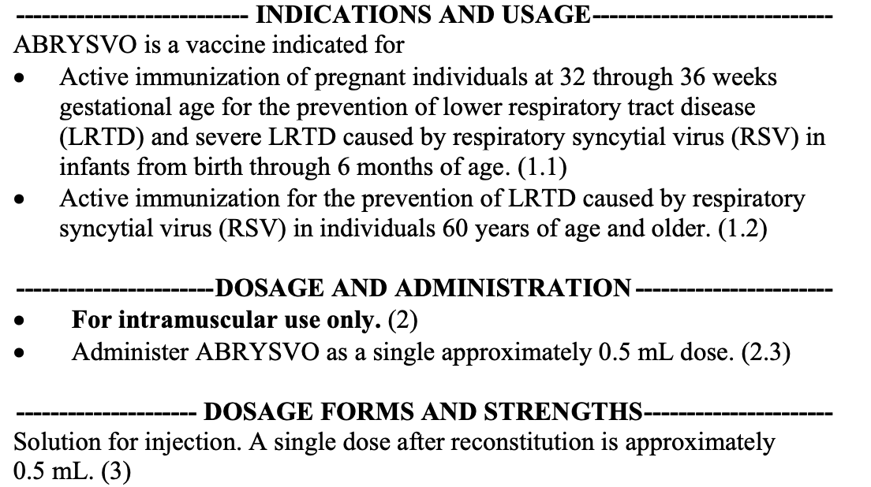
RSVPreF3 OA (Arexvy, GSK)
RSVpreF (Abrysvo, Pfizer)

Slide 17
Who Should Get the RSV Vaccine?
Underlying medical conditions associated with increased risk
Lung disease (COPD and asthma)
CV diseases (CHF and CAD)
Moderate or severe immune compromise
Diabetes mellitus
Neurologic or neuromuscular conditions
Kidney disorders
Liver disorders
Hematologic disorders
Other underlying conditions that a HCP determines might increase the risk for severe respiratory disease
Other factors associated with increased risk
Frailty
Advanced age
Residence in a nursing home or other long-term care facility
Other underlying conditions that a HCP determines might increase the risk for severe respiratory disease
June 21, 2023:
ACIP recommended that adults aged ≥60 years may receive a single dose of RSV vaccine, using shared clinical decision-making
Shared clinical decision-making includes a discussion between the health care provider and the patient, which might be guided by the patient’s risk for disease and their characteristics, values, and preferences; the provider’s clinical discretion; and the characteristics of the vaccine.
Centers for Disease Control and Prevention | MMWR | July 21, 2023 | Vol. 72 | No. 29. Melga M, et al. MMWR Mobidity and Mortality Weekly Report. 2023;72(29):793-801.

Slide 18
Candidates in late phase development for older adults using three approaches: (1) nucleic acid, (3) subunit, (4) vector-based
MVA-BN-RSV vector vaccine (phase 2)
mRNA-1345 vaccine (phase 2/3)
Ad26.RSV.pre-F vector vaccine (phase 3) ON HOLD

Slide 19
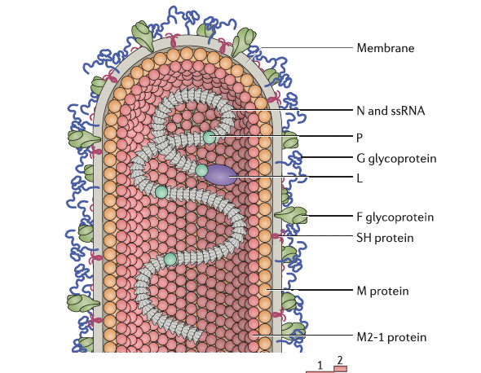
RSV Virology
Battles MB, McLellan JS. Nat Rev Microbiol. 2019;17(4):233-245.

Slide 20
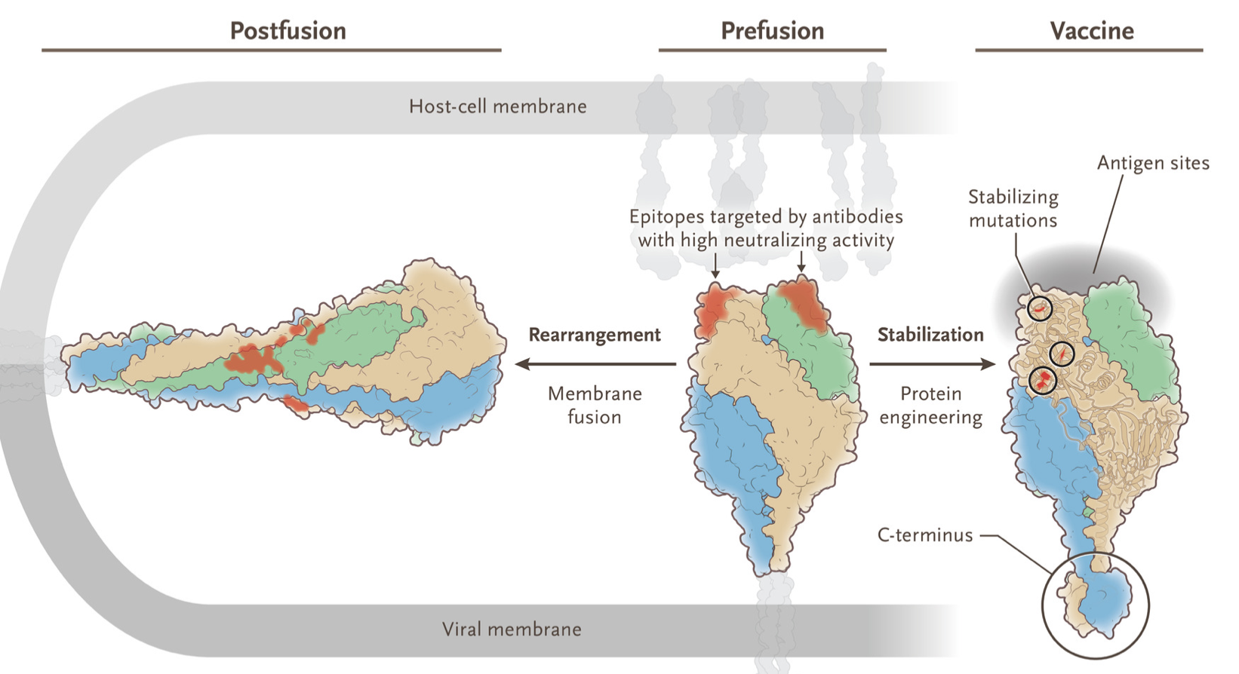
RSV Immunology
B and T cell responses
YY
Y
YY
YY
YY
YY
Battles MB, McLellan JS. Nat Rev Microbiol. 2019;17(4):233-245.
Graham BS. N Engl J Med. 2023;388(7):579-581.

Slide 21
Therapeutic and Vaccine Approaches to RSV
Strategy | Target population | NOTE
Antiviral small molecule | Pediatric and adult | Multiple products in development. Ribavirin available now
Monoclonal antibody | Pediatric | Several products in development. Palivizumab available now
Vaccine | Pediatric, pregnant women and older adults | Multiple products at various stages of development

Slide 22
Pre-fusion Protein Based Vaccines for Older Adults approved or in Late-Stage Development
Platform | Name | Manufacturer
Subunit | RSVPreF3 OA | GSK
Subunit | RSVPreF | Pfizer
mRNA | mRNA-1777 | Moderna
Adenovirus | Ad26.RSV.preF-RSV preF | Janssen
Graham BS. N Engl J Med. 2023;388(7):579-581.

Slide 23
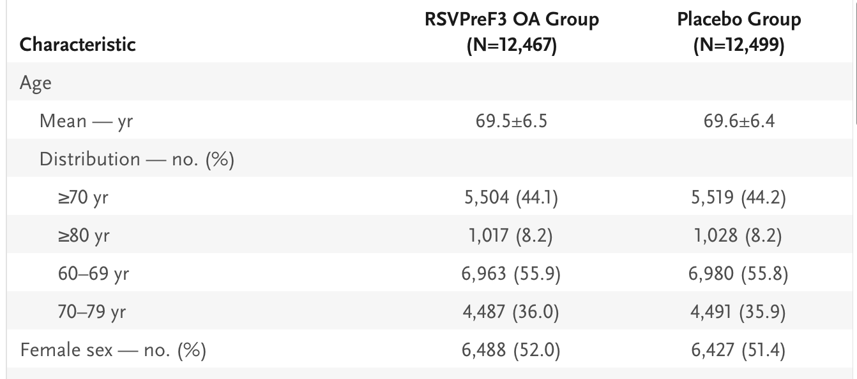
Phase 3 Clinical Trial of RSVPreF3 OA
Primary Objective: Demonstrate efficacy of RSV vaccine in preventing RT-PCR-confirmed RSV LRTD in adults ≥ 60 years of age during first season
Papi A et al. N Engl J Med. 2023;388(7):595-608.
FDA Vaccines and Related Biological Products Advisory Committee March 1, 2023

Slide 24
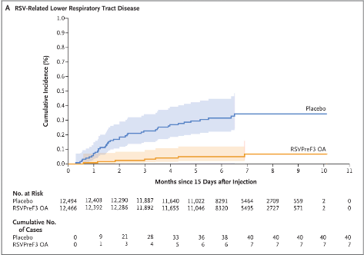
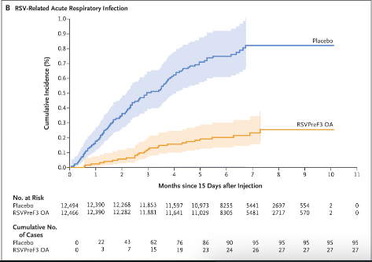
Efficacy of RSVPreF3 OA
RSV-related Lower Respiratory Tract Disease (LRTD)
RSV-related Acute Respiratory Infection
Papi A et al. N Engl J Med. 2023;388(7):595-608.

Slide 25
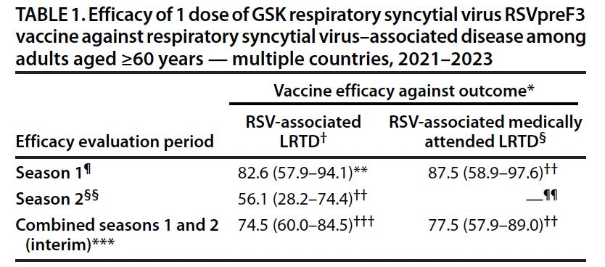
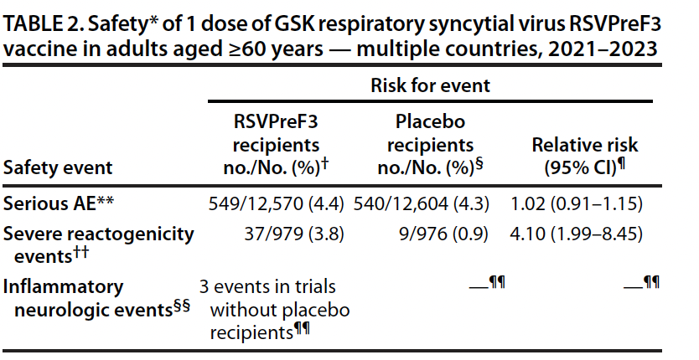
Efficacy and Safety of RSVPreF3 OA
Reaction | Vaccine % | Placebo %
General/local | 33 | 18
Nervous system | 6 | 4
Respiratory | 4 | 4
Musculoskeletal | 4 | 3
Infection | 4 | 4
GI | 3 | 2
Across all RSVPreF3 trials inflammatory neurologic events were reported in three of 17,922 adults vaccinated with RSVPreF3. Events included one case of GBS and two cases of acute disseminated encephalomyelitis
Centers for Disease Control and Prevention | MMWR | July 21, 2023 | Vol. 72 | No. 29 ;
FDA Vaccines and Related Biological Products Advisory Committee Meetings February 28 and March 1, 2023

Slide 26
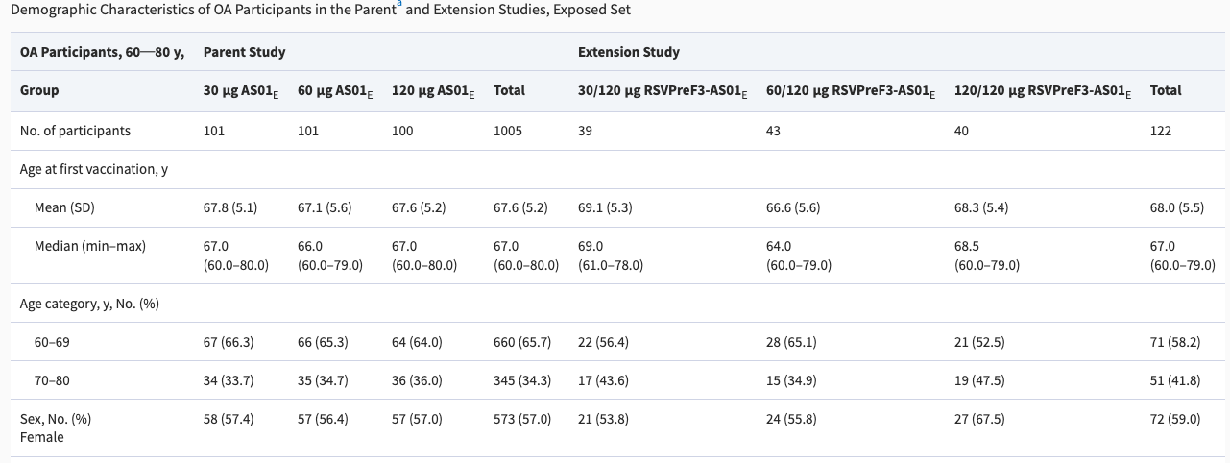
Phase 2b Clinical Trial of Revaccination with RSVPreF3 OA
Primary Objective: To evaluate the safety, reactogenicity, and immunogenicity of 120 μg RSVPreF3, administered as the third vaccine dose (dose 3) 18 months after dose 2 in participants who had received 2 doses of the RSVPreF3 containing 30, 60, or 120 μg of RSVPreF3.
Leroux-Roels I, et al. J Infect Dis 2023;Sep 12:jiad321. Online ahead of print.

Slide 27
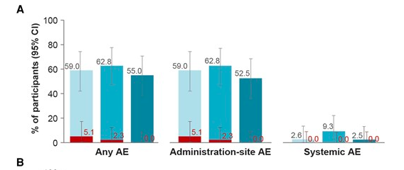
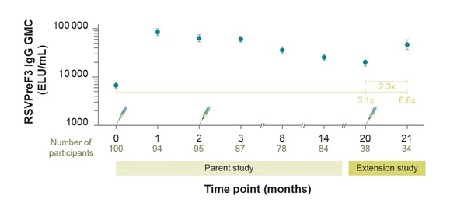
Phase 2b Clinical Trial of Revaccination with RSVPreF3 OA
Percentage of participants reporting (A) at least 1 solicited AE (any, administration-site, and systemic adverse event) within 4 days,
Humoral immune responses in terms of RSVPreF3-specific IgG GMCs (ELU/mL) in the 120/120 μg RSVPreF3 group
Leroux-Roels I, et al. J Infect Dis 2023;Sep 12:jiad321. Online ahead of print.

Slide 28
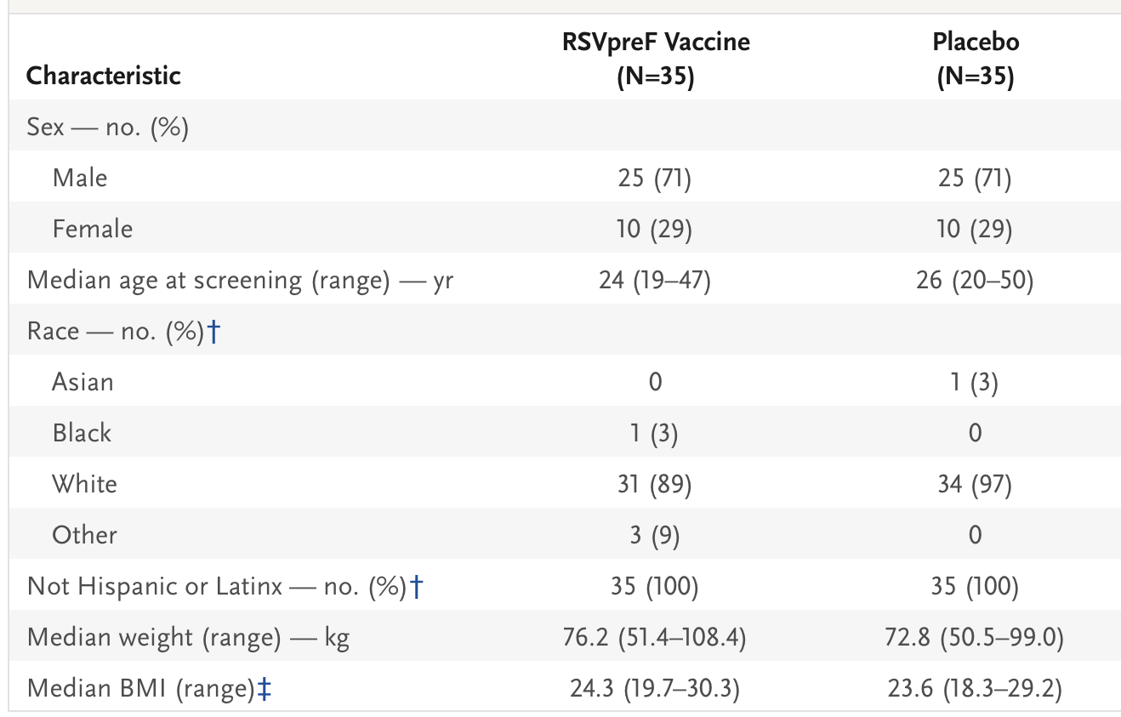
RSVpreF Adult RSV Challenge Study (Phase 2b)
Primary Objective
RT-qPCR−confirmed detectable RSV infection on at least 2 consecutive days with at least one clinical symptom of any grade from two categories or at least one grade 2 symptom from any category, the total symptom score from day 1 to discharge, and the area under the curve (AUC) for the RSV viral load in nasal-wash samples measured by means of RT-qPCR from day 2 after challenge to discharge
Schmoele-Thoma B et al. N Engl J Med. 2022;386(25):2377-2386.

Slide 29
RSVpreF Adult RSV Challenge Study (Phase 2b)
Schmoele-Thoma B et al. N Engl J Med. 2022;386(25):2377-2386.

Slide 30
Efficacy and Safety of RSVpreF in Older Adults
Primary Objective: Efficacy of RSVpreF vaccine in preventing RSV-associated LRTD with at least 2 signs or symptoms (cough, wheezing, sputum production, shortness of breath, or tachypnea) lasting more than 1 day and RSV infection that was confirmed by means of RT-PCR assay within 7 days after onset of signs or symptoms.
Walsh EE et al. N Engl J Med. 2023;388(16):1465-1477.

Slide 31
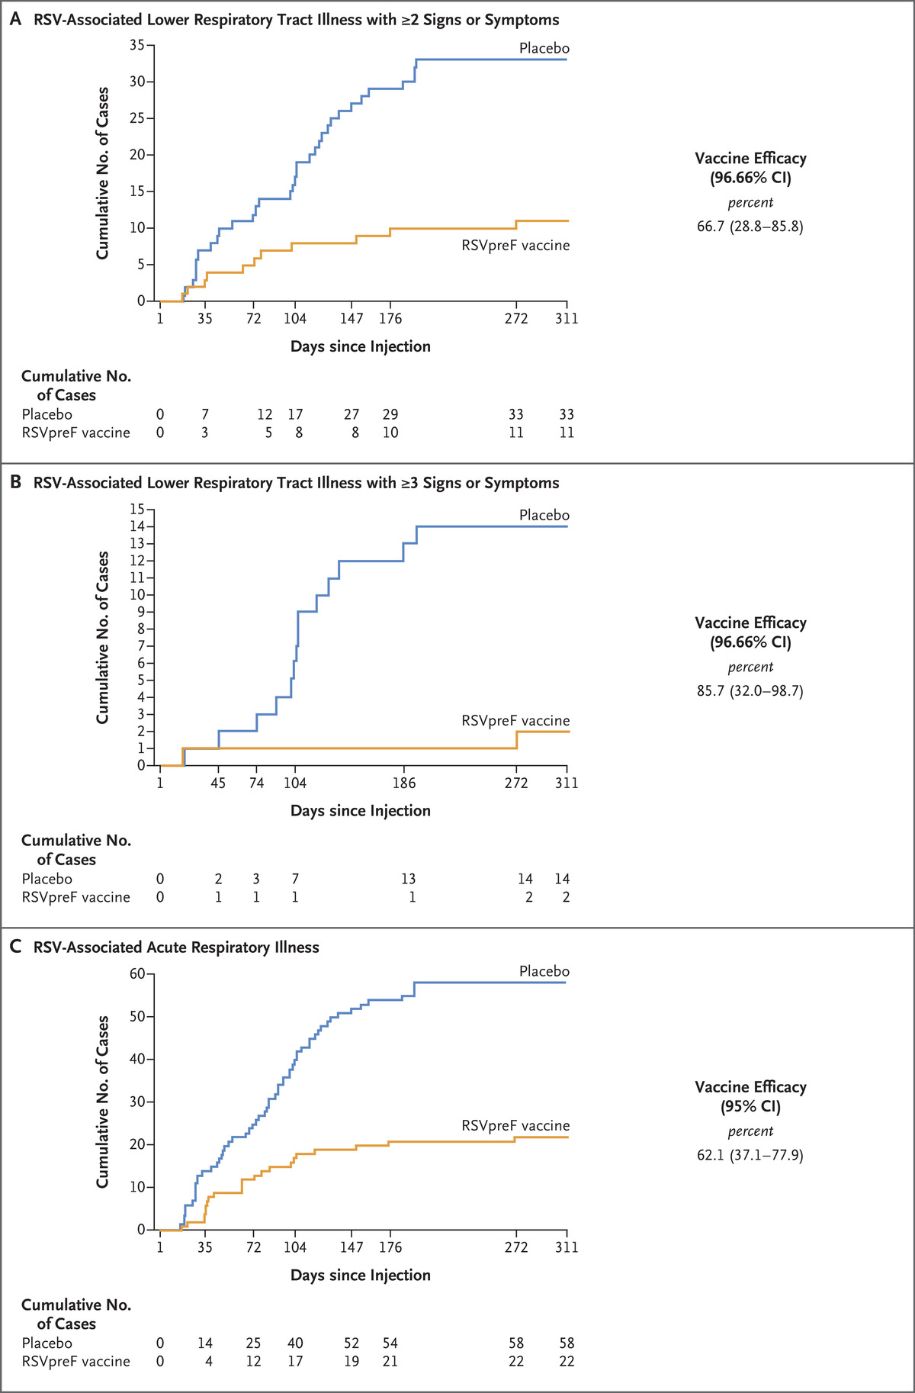
Efficacy and Safety of RSVpreF in Older Adults
New or increased: sore throat, nasal symptoms (respiratory tract symptom): cough, wheezing, sputum, dyspnea, tachypnea (lower respiratory tract symptom)
Walsh EE et al. N Engl J Med. 2023;388(16):1465-1477.

Slide 32
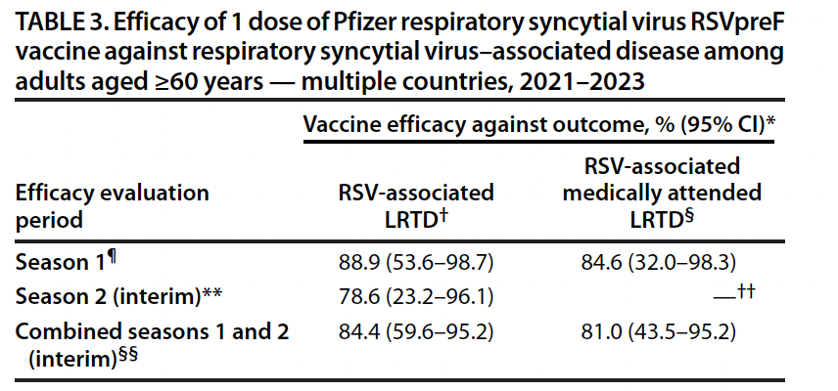
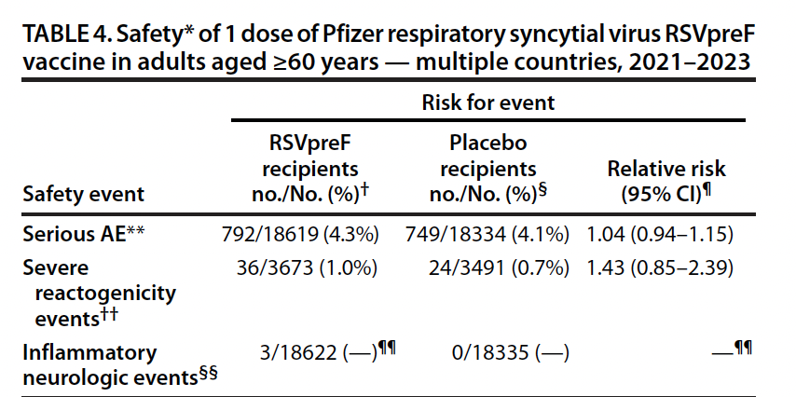
RSVpreF recombinant stabilized preF vaccine
Reaction | Vaccine % | Placebo %
Local reaction | 12.2 | 6.6
fatigue | 15.5 | 14.4
headache | 12.8 | 11.7
Muscle pain | 10.1 | 8.4
Joint pain | 7.5 | 6.9
GI | 3.4-5.9 | 3.7-5.2
Across all RSVpreF clinical trials, inflammatory neurologic events were reported in three of 20,255 adults. The events included GBS, Miller Fisher syndrome (a GBS variant), and undifferentiated motor-sensory axonal polyneuropathy.
Centers for Disease Control and Prevention | MMWR | July 21, 2023 | Vol. 72 | No. 29 ;
FDA Vaccines and Related Biological Products Advisory Committee Meetings
February 28 and March 1, 2023

Slide 33
Efficacy and Safety of RSVpreF in Older Adults
Lower respiratory tract infection (LRTI) defined as: New or increased cough, wheezing, sputum, dyspnea, tachypnea
> 2 LRTI symptoms
Vaccine Efficacy %
FDA Vaccines and Related Biological Products Advisory Committee Meeting February 28, 2023

Slide 34
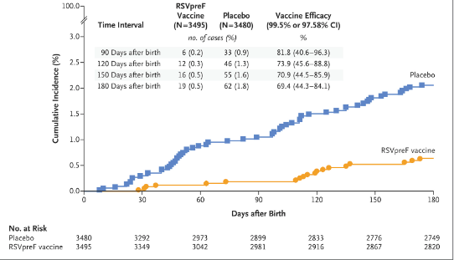
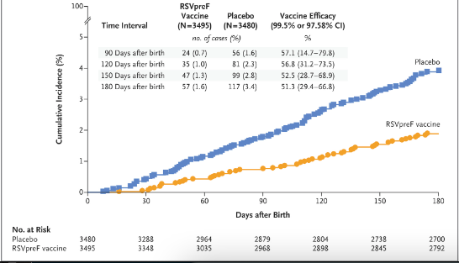
RSVpreF in Pregnant Women 32 to 36 Weeks of Gestation
Primary Endpoints: Medically attended severe RSV-associated LRTD and medically attended RSV-associated LRTD in infants within 90, 120, 150, and 180 days after birth
Medically attended severe RSV-associated LRTD
Medically attended RSV-associated LRTD
Percentages of maternal participants with any AEs reported within 1 month after injection were similar in both vaccine and placebo groups
Percentages of infant participants with any adverse events reported within 1 month after birth were 37.1% in the vaccine group and 34.5% in the placebo group
Kampmann B, et al. NEJM. 2023;388:1451-1464.

Slide 35
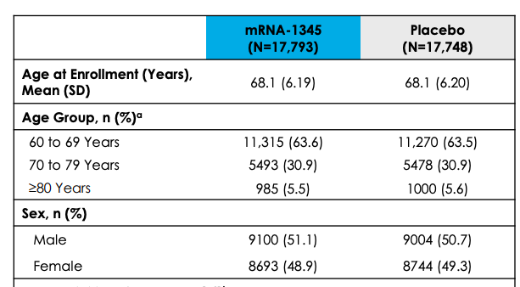
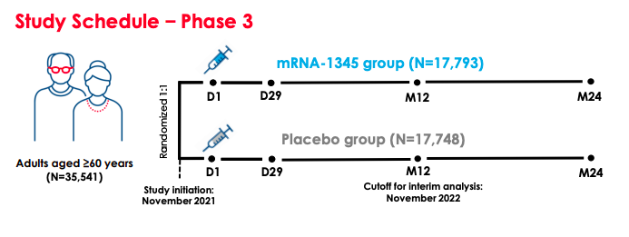
Phase 3 Trial Interim Results: mRNA 1345 in Adults ≥60 YOA
Primary efficacy endpoints: RSV-LRTD defined as either two or more or three or more symptoms of disease.
Efficacy of mRNA-1345 Against RSV LRTD
Well-tolerated and had an acceptable safety profile; solicited adverse reactions were mostly grade 1 or grade 2 in severity
Phase 3 trial ongoing
LRTD=lower respiratory tract disease
https://classic.clinicaltrials.gov/ct2/show/NCT05127434. https://s29.q4cdn.com/435878511/files/doc_downloads/program_detail/2023/09/RSV-09-13-23.pdf

Slide 36
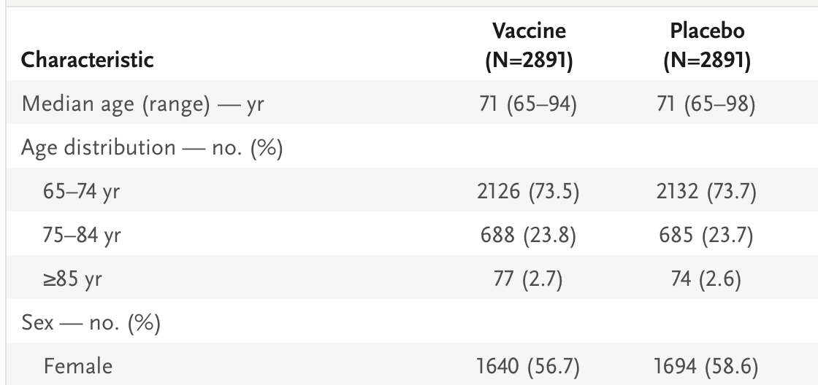
Ad26.RSV.preF–RSV preF Protein Vaccine in Older Adults
Falsey AR et al. N Engl J Med. 2023;388(7):609-620.

Slide 37
Factors Associated with Vaccine Hesitancy
COVID-19 vaccine hesitancy has been associated with
younger age (eg, <60 years old),
lower levels of education,
lower household income,
rural residence, and
lack of health insurance
In a CDC survey, main reasons for non-intent to receive vaccine were vaccine side effects, safety and lack of trust
Nguyen MMWR Morb Mortal Wkly Rep. 2021;70(6):217. Epub 2021 Feb 12. Fischer Ann Intern Med. 2020;173(12):964. Epub 2020 Sep 4. ElMohandes Sci Rep. 2021;11(1):21844. Epub 2021 Nov 4.

Slide 38
Vaccine Hesitancy
Lack of awareness about eligibility or availability
Belief that they remain protected against severe infection without it
Uncertainty about the vaccine safety and efficacy
Highlights the role for clinicians in educating patients on emerging vaccine data and recommendations.
Sinclair MMWR Morb Mortal Wkly Rep. 2023;72(3):73. Epub 2023 Jan 20

Slide 39
What can providers do to help with vaccines?
Physicians can improve vaccine acceptance in individual patients by
identifying concerns,
making direct recommendations for vaccination,
educating patients on vaccine risks and benefits, and
dispelling misconceptions about the disease and the vaccine.

Slide 40
Thank you!
Questions and Answers

